Slide 1

Responses to COVID19 in Buddhist Communities of Contemporary China
Preliminary Findings
Daigengna Duoer
Ph.D. Student
Religious Studies, UC Santa Barbara

Slide 2
Responses to COVID19 in Buddhist Communities of Contemporary China
Preliminary Findings
Purpose: to provide teaching materials on Buddhism and COVID19
Sources: Websites, Wechat, Weibo, applications
Results: preliminary, not exhaustive at all; will continue to trace new developments

Slide 3
Table of Contents:
Government regulations on Buddhist sites in response to COVID-19
Buddhist responses to regulations and COVID-19
  Lockdown from the public, social distancing, hygiene practices and health checks
  Creation of online platforms for virtual practice and study
  Online outreach to the laity (virtual teachings, virtual ritual assistance, online sutra-copying)
  Donations made to the communities in need
  Alternative ways to raise money and to be self-sustaining (monastic agriculture)
  Promotion and use of Chinese traditional medicine (CTM) for COVID-19 treatment and prevention (herbal medicine and qigong)
  Sharing of personal experiences
  Understanding the virus from doctrinal points of view and promoting vegetarianism

Slide 4
Table of Contents:
Government regulations on Buddhist sites in response to COVID-19
Buddhist responses to regulations and COVID-19
  Lockdown from the public, social distancing, hygiene practices and health checks
  Creation of online platforms for virtual practice and study
  Online outreach to the laity (virtual teachings, virtual ritual assistance, online sutra-copying)
  Donations made to the communities in need
  Alternative ways to raise money and to be self-sustaining (monastic agriculture)
  Promotion and use of Chinese traditional medicine (CTM) for COVID-19 treatment and prevention (herbal medicine and qigong)
  Sharing of personal experiences
  Understanding the virus from doctrinal points of view and promoting vegetarianism

Slide 5
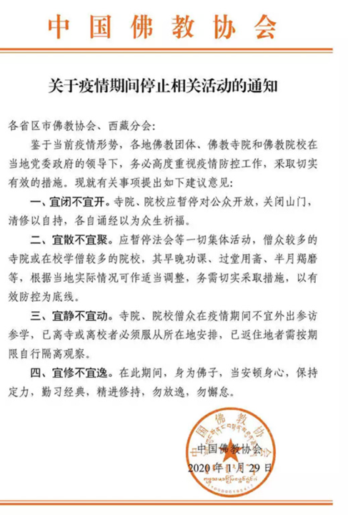
Buddhist Association of China: Guidance on Halting Related (Religious) Activities During the Epidemic (Jan 29, 2020)
Temporary closure to the public. Permanent monastic residence encouraged to focus on self-cultivation, sutra chanting and making merit.
Social distancing. All group religious activities must stop. Activities that require group gatherings, such as classes, meals, and meetings should be carried out with caution.
Avoid unnecessary travel. Field trips and temple visits are discouraged. Those who have already left their home temple should follow local orders and stay put. Those who have returned must be observed under quarantine.
Self-cultivation. During the epidemic, disciples of the Buddha should calm their bodies and minds and be diligent in their trainings.

Slide 6
Table of Contents:
Government regulations on Buddhist sites in response to COVID-19
Buddhist responses to regulations and COVID-19
  Lockdown from the public, social distancing, hygiene practices and health checks
  Creation of online platforms for virtual practice and study
  Online outreach to the laity (virtual teachings, virtual ritual assistance, online sutra-copying)
  Donations made to the communities in need
  Alternative ways to raise money and to be self-sustaining (monastic agriculture)
  Promotion and use of Chinese traditional medicine (CTM) for COVID-19 treatment and prevention (herbal medicine and qigong)
  Sharing of personal experiences
  Understanding the virus from doctrinal points of view and promoting vegetarianism

Slide 7
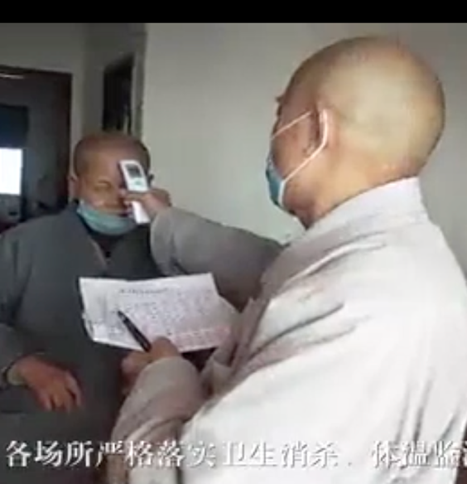
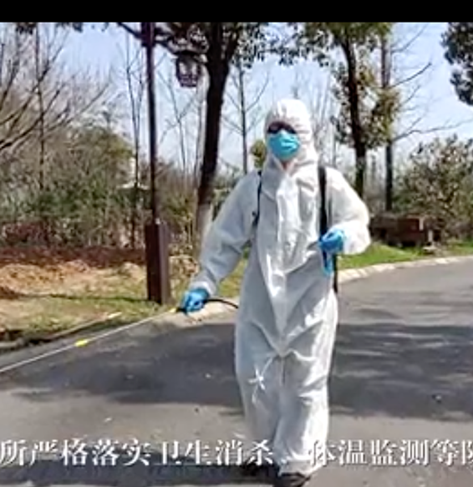

Slide 8
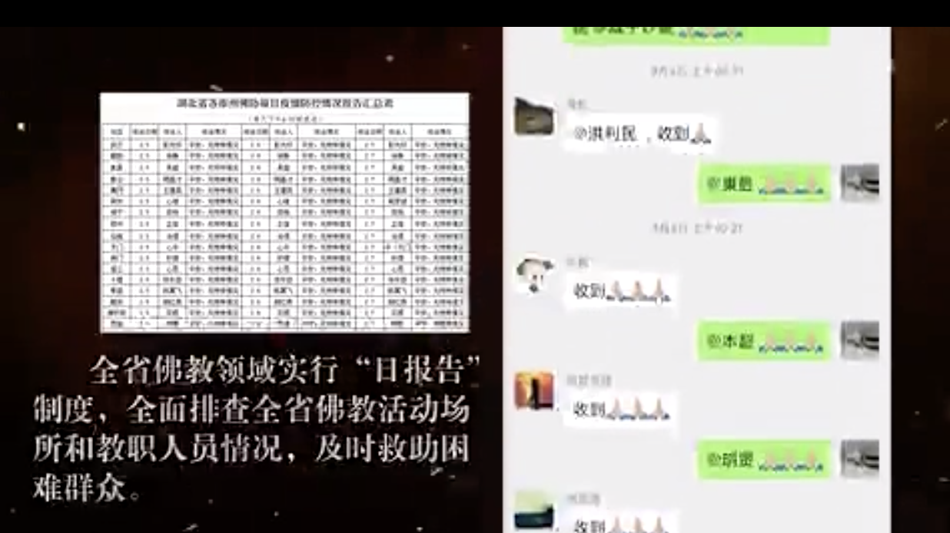

Slide 9
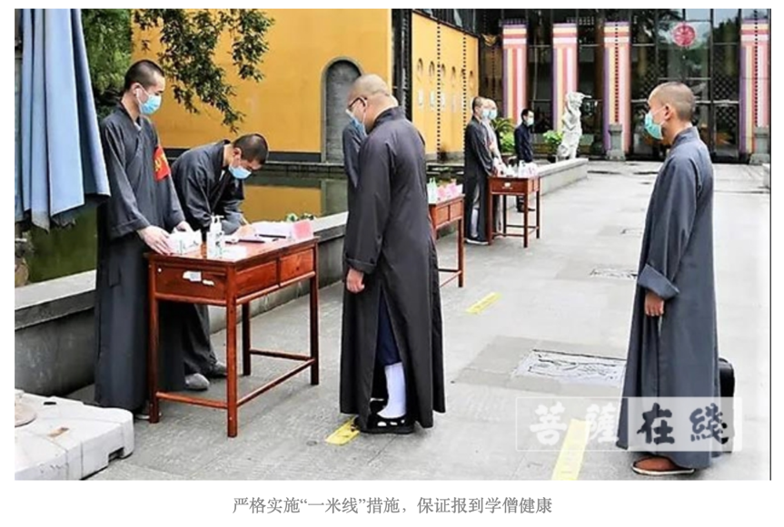
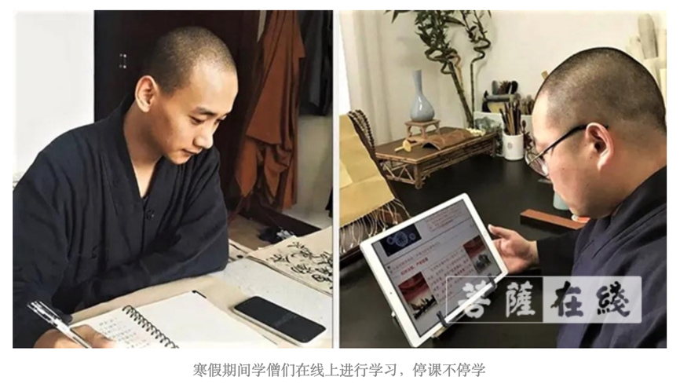

Slide 10
Table of Contents:
Government regulations on Buddhist sites in response to COVID-19
Buddhist responses to regulations and COVID-19
  Lockdown from the public, social distancing, hygiene practices and health checks
  Creation of online platforms for virtual practice and study
  Online outreach to the laity (virtual teachings, virtual ritual assistance, online sutra-copying)
  Donations made to the communities in need
  Alternative ways to raise money and to be self-sustaining (monastic agriculture)
  Promotion and use of Chinese traditional medicine (CTM) for COVID-19 treatment and prevention (herbal medicine and qigong)
  Sharing of personal experiences
  Understanding the virus from doctrinal points of view and promoting vegetarianism

Slide 11
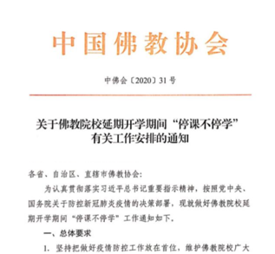
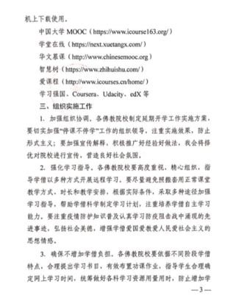
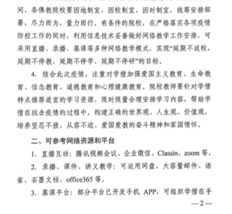
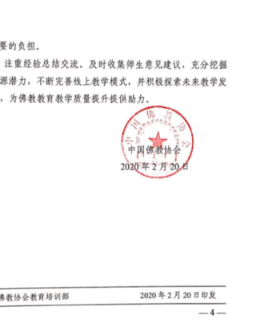
Buddhist Association of China: Guidance on “Continued Learning” for Buddhist Studies Colleges during the Epidemic (Feb 20, 2020)
To make sure that monastic education is not discontinued during the lockdown.
Encourages also online learning outside of the monastic curriculum (Xuexi qiangguo app, Coursera, edX, etc.)
Emphasize in “patriotic education, life education, ideological education, moral education, and psychological health.”
Explore potentials for alternative platforms of education.

Slide 12
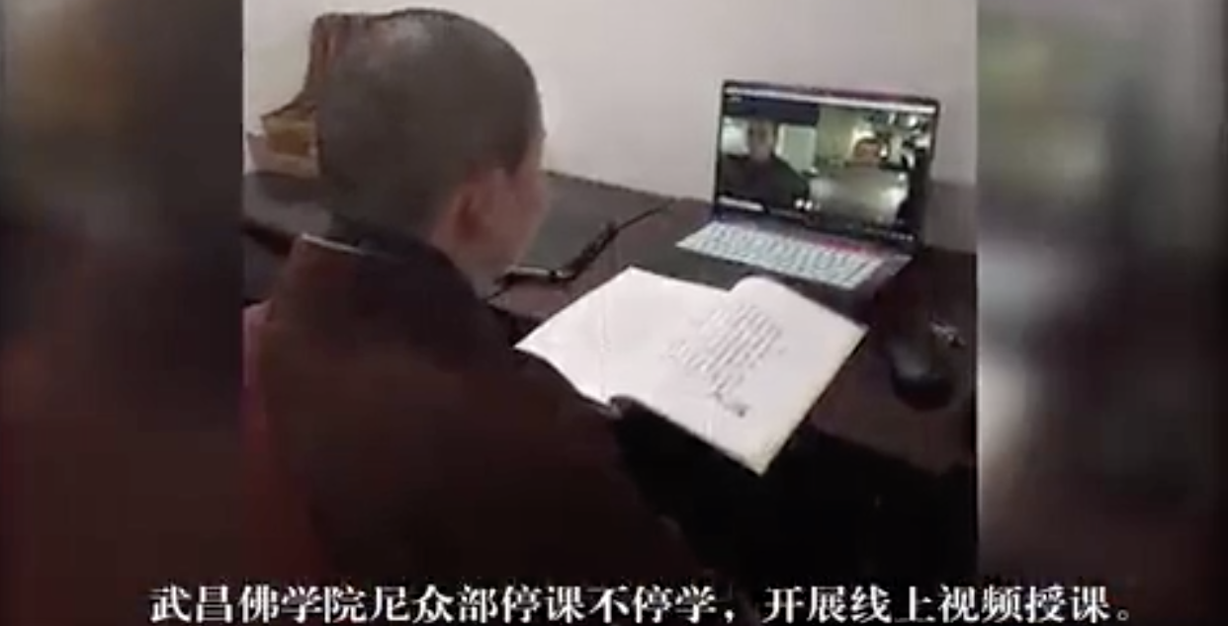

Slide 13

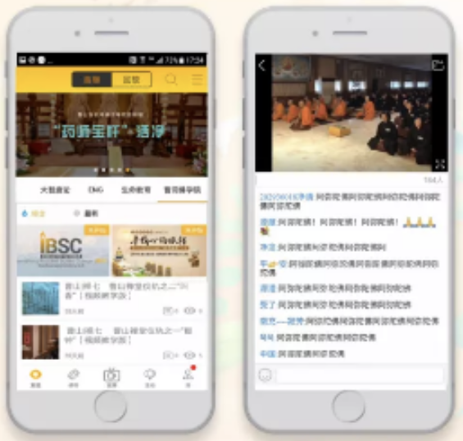

Slide 14
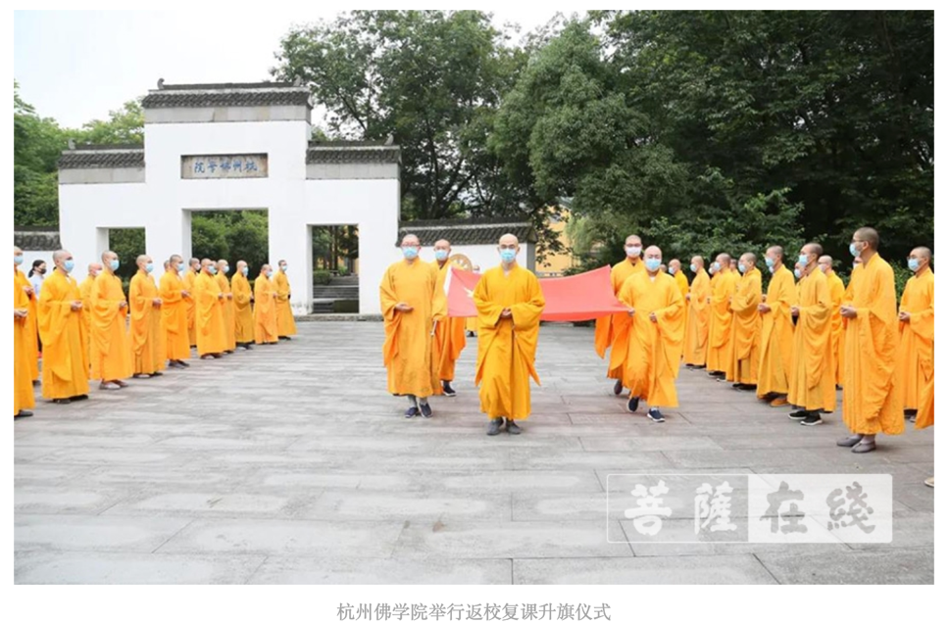

Slide 15
Table of Contents:
Government regulations on Buddhist sites in response to COVID-19
Buddhist responses to regulations and COVID-19
  Lockdown from the public, social distancing, hygiene practices and health checks
  Creation of online platforms for virtual practice and study
  Online outreach to the laity (virtual teachings, virtual ritual assistance, online sutra-copying)
  Donations made to the communities in need
  Alternative ways to raise money and to be self-sustaining (monastic agriculture)
  Promotion and use of Chinese traditional medicine (CTM) for COVID-19 treatment and prevention (herbal medicine and qigong)
  Sharing of personal experiences
  Understanding the virus from doctrinal points of view and promoting vegetarianism

Slide 16
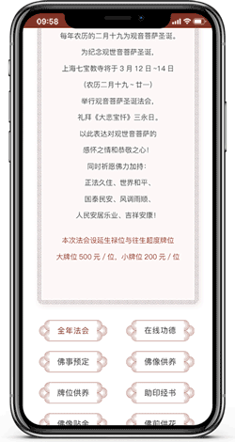
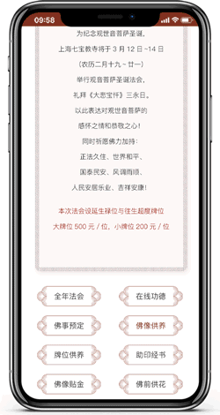

Slide 17
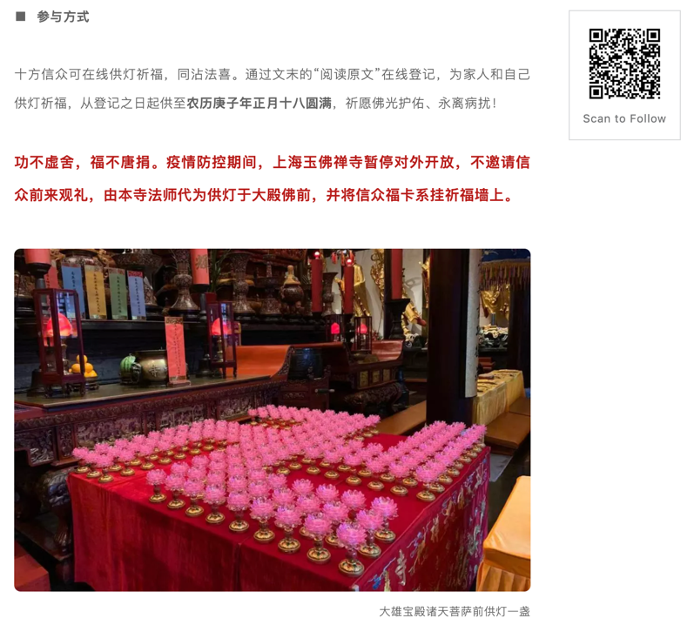

Slide 18
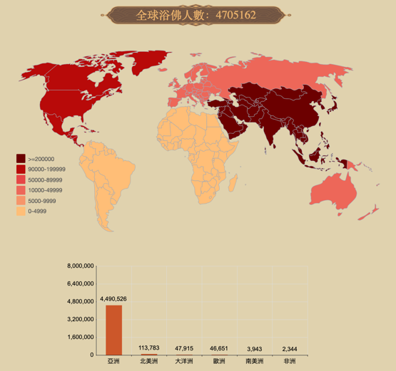
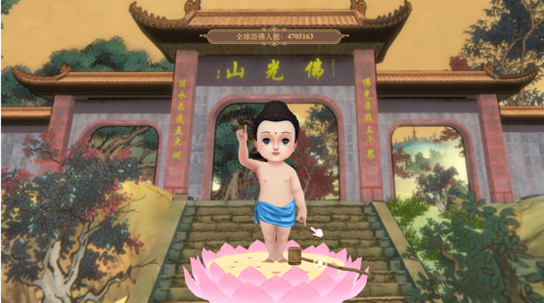

Slide 19
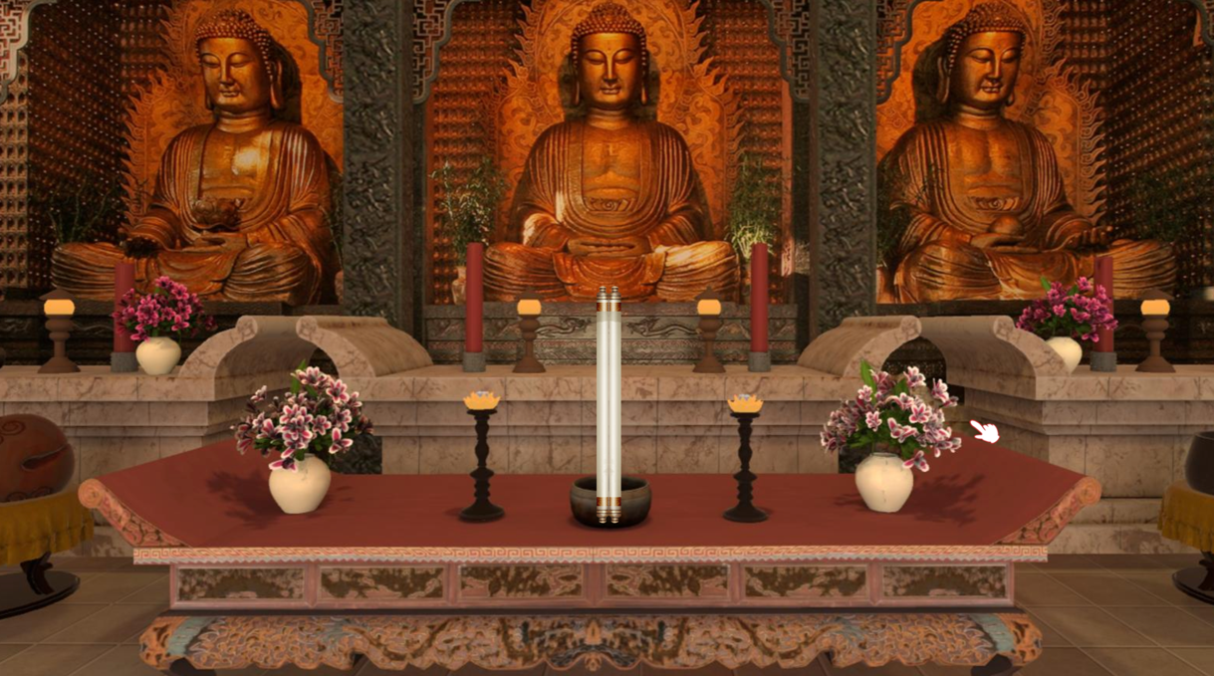

Slide 20
Table of Contents:
Government regulations on Buddhist sites in response to COVID-19
Buddhist responses to regulations and COVID-19
  Lockdown from the public, social distancing, hygiene practices and health checks
  Creation of online platforms for virtual practice and study
  Online outreach to the laity (virtual teachings, virtual ritual assistance, online sutra-copying)
  Donations made to the communities in need
  Alternative ways to raise money and to be self-sustaining (monastic agriculture)
  Promotion and use of Chinese traditional medicine (CTM) for COVID-19 treatment and prevention (herbal medicine and qigong)
  Sharing of personal experiences
  Understanding the virus from doctrinal points of view and promoting vegetarianism

Slide 21
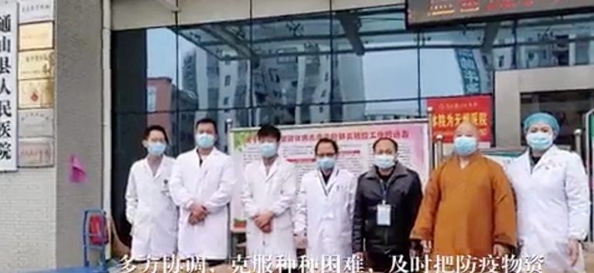
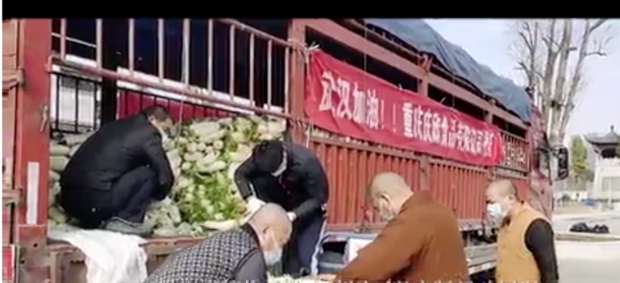
As of March 25, 2020, Buddhist communities in Hubei alone have donated more than 23,000,000 Yuan (3.28 million USD) to the frontline.
Much more if counting Buddhist communities from all over the country, as well as donations coming in from abroad.

Slide 22
Table of Contents:
Government regulations on Buddhist sites in response to COVID-19
Buddhist responses to regulations and COVID-19
  Lockdown from the public, social distancing, hygiene practices and health checks
  Creation of online platforms for virtual practice and study
  Online outreach to the laity (virtual teachings, virtual ritual assistance, online sutra-copying)
  Donations made to the communities in need
  Alternative ways to raise money and to be self-sustaining (monastic agriculture)
  Promotion and use of Chinese traditional medicine (CTM) for COVID-19 treatment and prevention (herbal medicine and qigong)
  Sharing of personal experiences
  Understanding the virus from doctrinal points of view and promoting vegetarianism

Slide 23
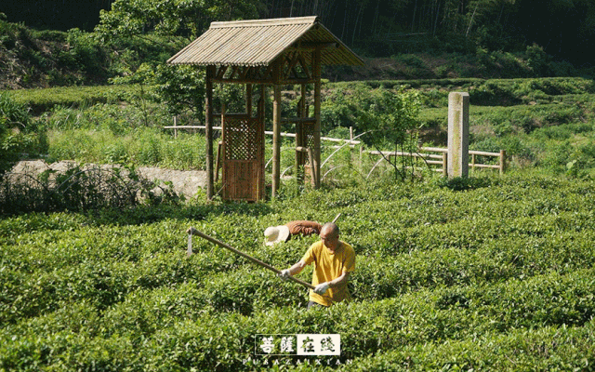

Slide 25
Table of Contents:
Government regulations on Buddhist sites in response to COVID-19
Buddhist responses to regulations and COVID-19
  Lockdown from the public, social distancing, hygiene practices and health checks
  Creation of online platforms for virtual practice and study
  Online outreach to the laity (virtual teachings, virtual ritual assistance, online sutra-copying)
  Donations made to the communities in need
  Alternative ways to raise money and to be self-sustaining (monastic agriculture)
  Promotion and use of Chinese traditional medicine (CTM) for COVID-19 treatment and prevention (herbal medicine and qigong)
  Sharing of personal experiences
  Understanding the virus from doctrinal points of view and promoting vegetarianism

Slide 26
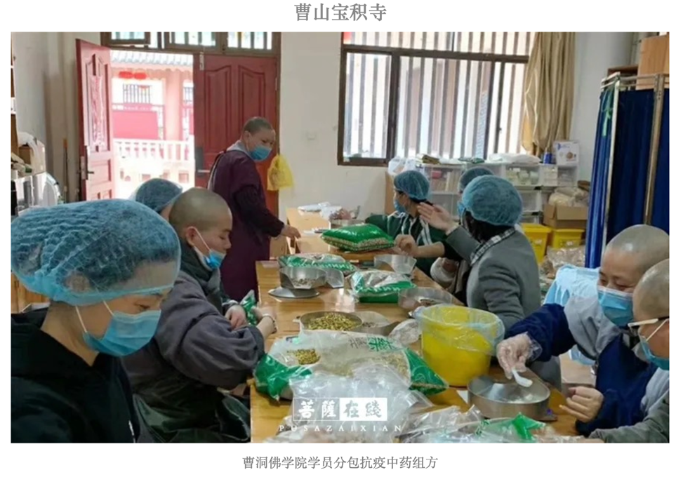

Slide 28
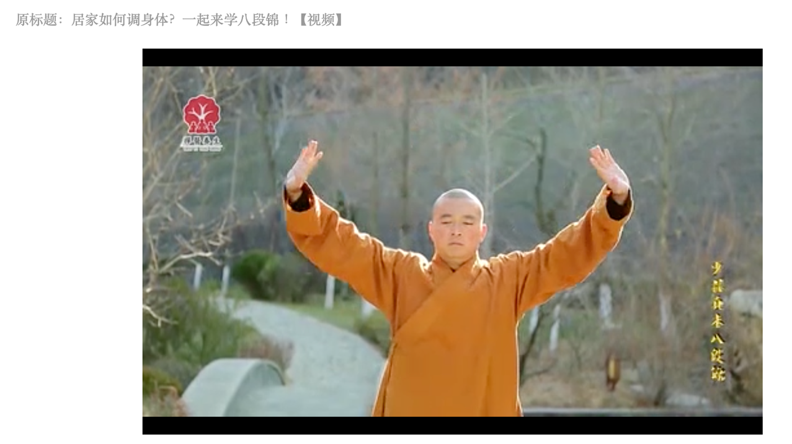

Slide 29
Table of Contents:
Government regulations on Buddhist sites in response to COVID-19
Buddhist responses to regulations and COVID-19
  Lockdown from the public, social distancing, hygiene practices and health checks
  Creation of online platforms for virtual practice and study
  Online outreach to the laity (virtual teachings, virtual ritual assistance, online sutra-copying)
  Donations made to the communities in need
  Alternative ways to raise money and to be self-sustaining (monastic agriculture)
  Promotion and use of Chinese traditional medicine (CTM) for COVID-19 treatment and prevention (herbal medicine and qigong)
  Sharing of personal experiences
  Understanding the virus from doctrinal points of view and promoting vegetarianism

Slide 30
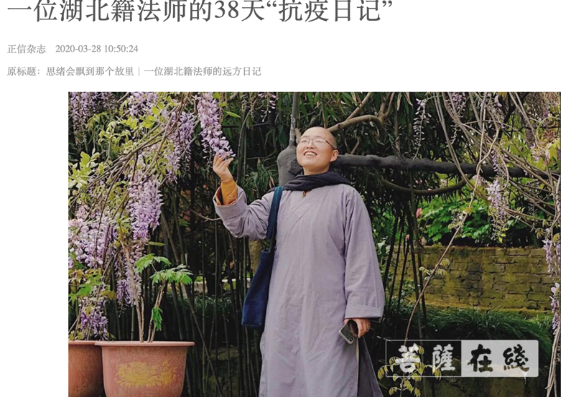
宽平法师

Slide 31
Table of Contents:
Government regulations on Buddhist sites in response to COVID-19
Buddhist responses to regulations and COVID-19
  Lockdown from the public, social distancing, hygiene practices and health checks
  Creation of online platforms for virtual practice and study
  Online outreach to the laity (virtual teachings, virtual ritual assistance, online sutra-copying)
  Donations made to the communities in need
  Alternative ways to raise money and to be self-sustaining (monastic agriculture)
  Promotion and use of Chinese traditional medicine (CTM) for COVID-19 treatment and prevention (herbal medicine and qigong)
  Sharing of personal experiences
  Understanding the virus from doctrinal points of view and promoting vegetarianism

Slide 32
Venerable Benxing on Buddhism in the Post-COVID19 Age:
In the post-COVID19 age, Buddhists should:
Reflect on karma and our relationship with the animal world
“Protect life; care for minds”
“Take up social responsibilities; strengthen Buddhism”
“Love our country and our religion”
“Take up responsibility in the affairs of the world”
“Enhance the traditions of Buddhist agriculture, academic research, and community outreach; co-operate with government bodies of all levels in serving the public to get through this epidemic."

