Slide 1

Buddhist Responses to COVID in Lumbini, Nepal
Amy langenberg, Eckerd college

Slide 2
from Phakchok Rinpoche, in retreat near Pharping, Nepal source: https://www.buddhistdoor.net/news/message-from-kyabgon-phakchok-rinpoche-on-the-coronavirus-pandemic
Response 1: pray and meditate
“On this New Moon today [24 March], we are offering a wholesome Riwo Sangcho ‘Mountain Smoke Offering’. Sang Offering is a skillful means of realizing the perfection of wisdom through the accumulation of merits with the practice of offerings and purification especially of impurities and obstructions.
These impurities and obstructions can manifest as diseases which are a result of causes and conditions. The causes and conditions, in this case, are our collective karma as human beings. So, to purify karma, you can practice virtue through your actions, your practice, your meditation, and so forth. This will remove our karmic debt. The most important part is to dedicate merit and make aspirations for our parents and family members in this life and past lives, our friends, for our villages, towns, and cities, and for all human beings. To dedicate and aspire for their good health, happiness, and fulfillment of all their wishes.”

Slide 3
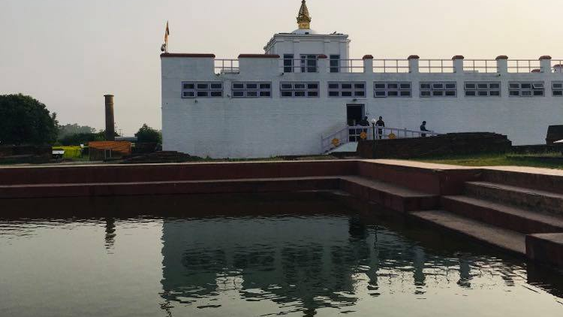
The Mayadevi Temple in Lumbini, Nepal

Slide 4
COVID totals in and around Lumbini
Rupendehi district: 320 cases and 1 death total
Kapilavastu district: 756 cases and 0 deaths total
Nepal: over 16,000 cases and 35 deaths total

Slide 5
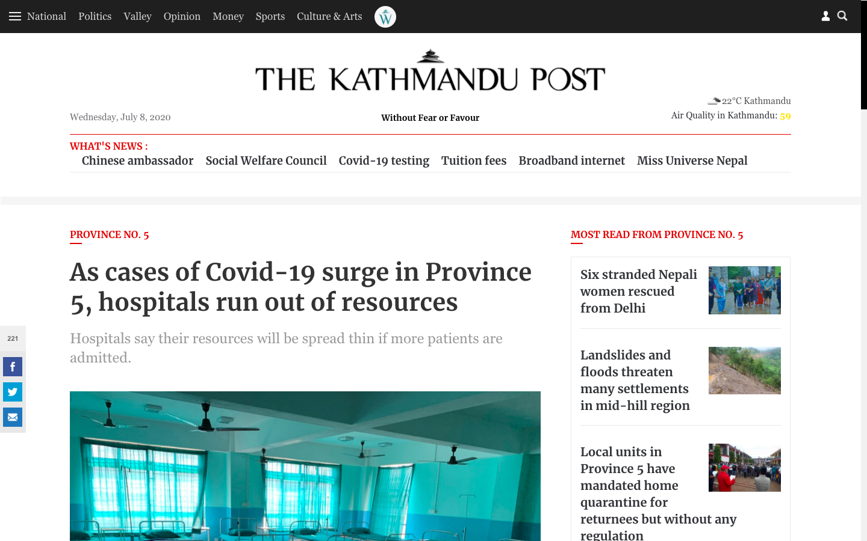

Slide 6
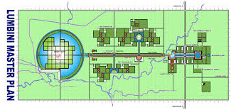

Slide 7



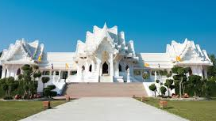
Response 2:
Close your doors,
turn your back

Slide 8


Slide 9
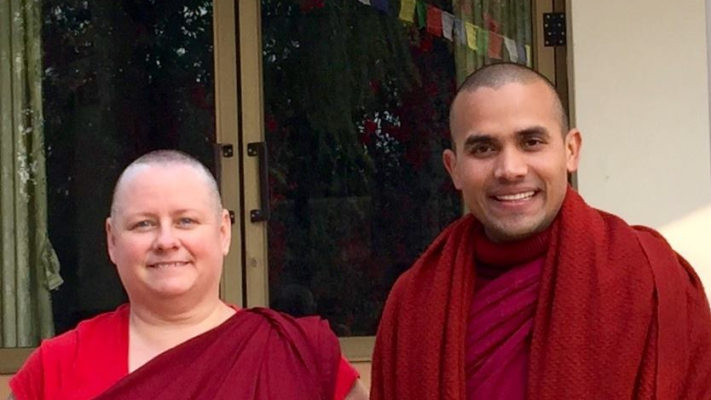
Venerable Metteyya Sakyaputta and
Venerable Bodhi Sakyadhita
Lumbini Social Service Foundation

Slide 10
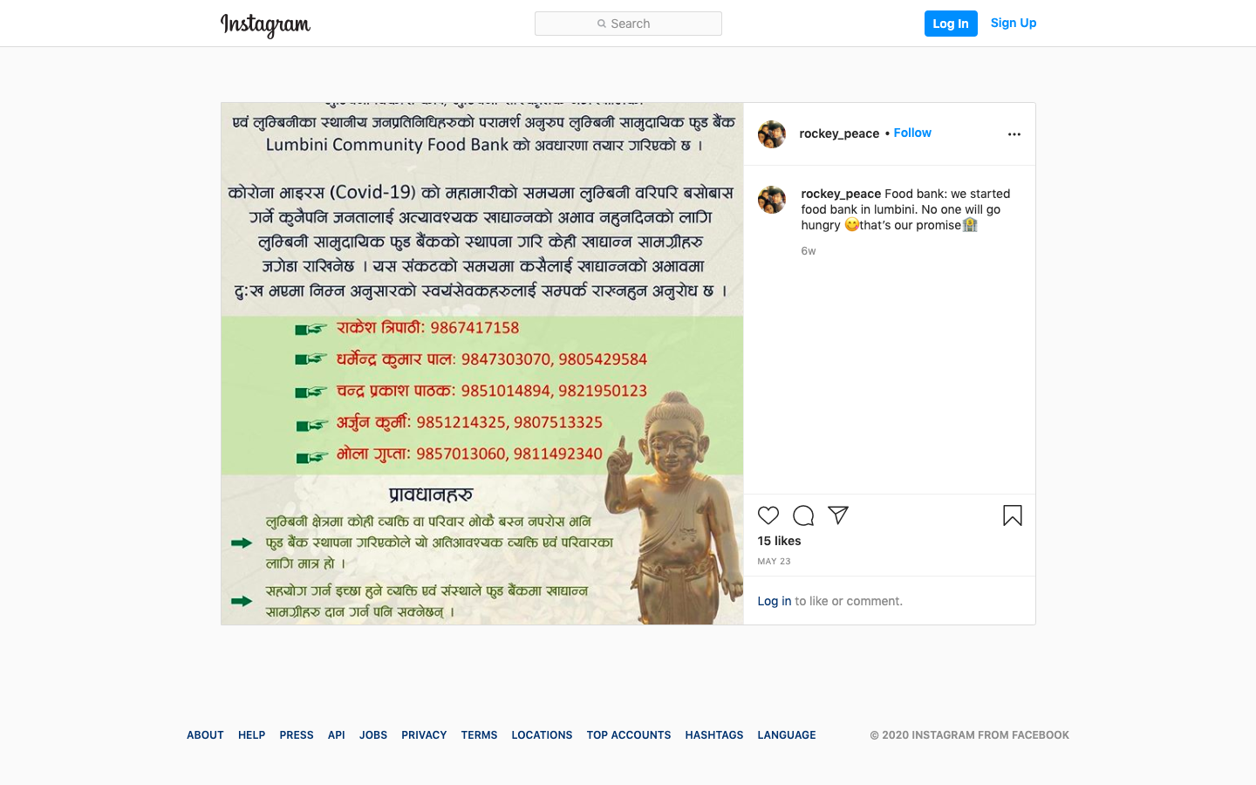

Slide 11
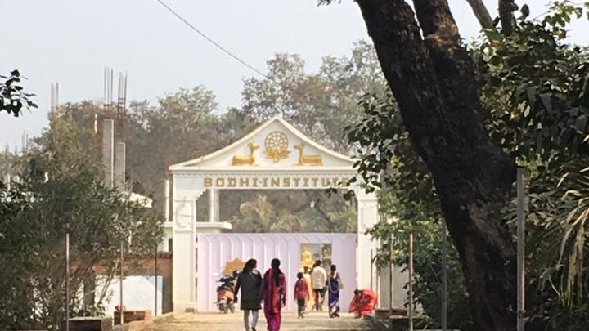

Slide 12
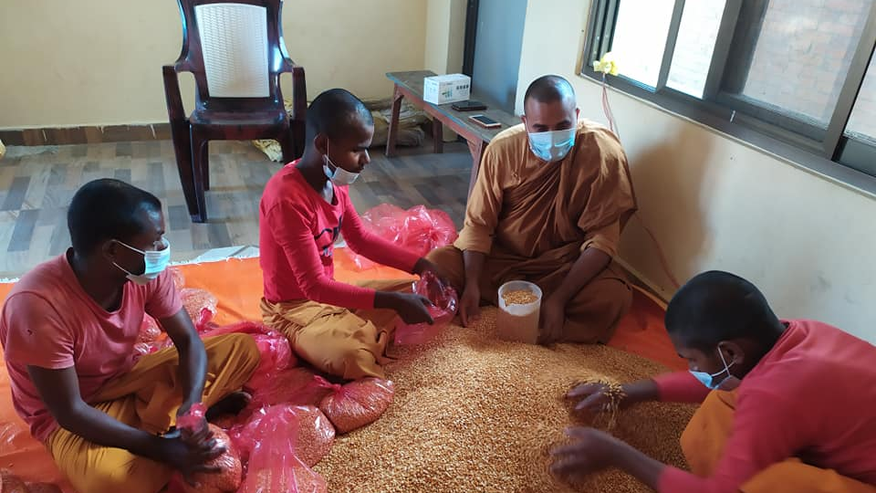

Slide 13
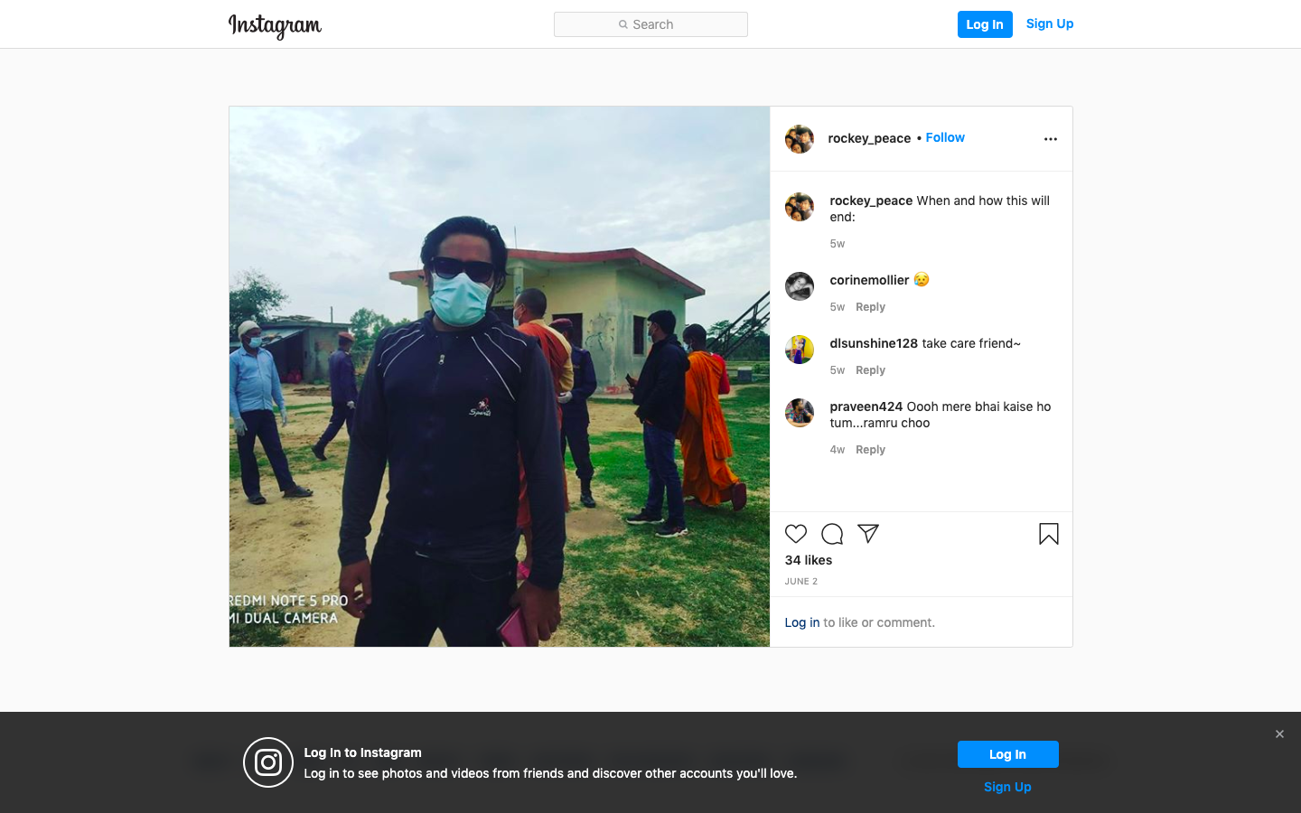

Slide 14
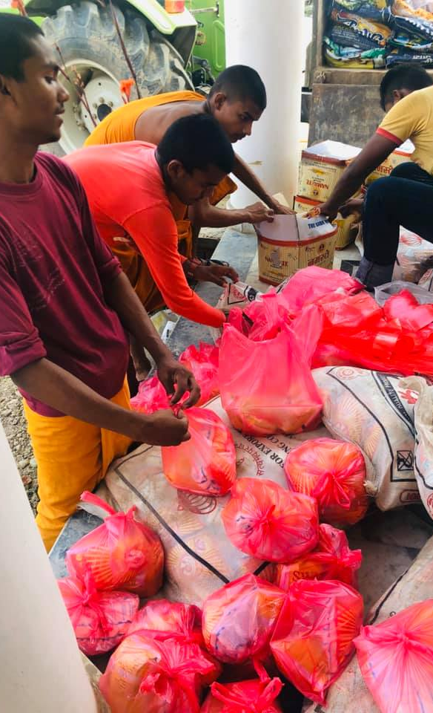
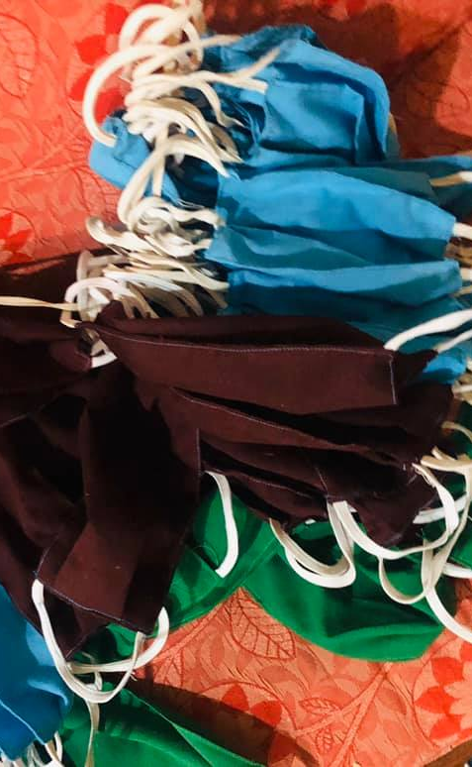
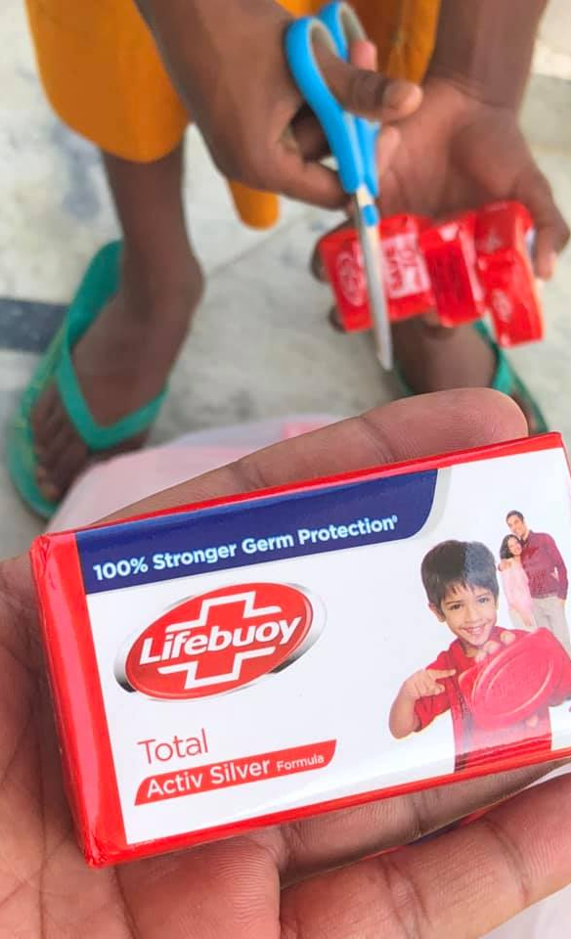

Slide 15
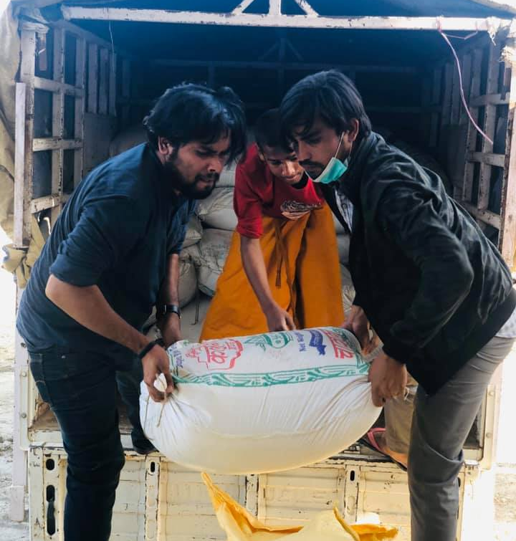
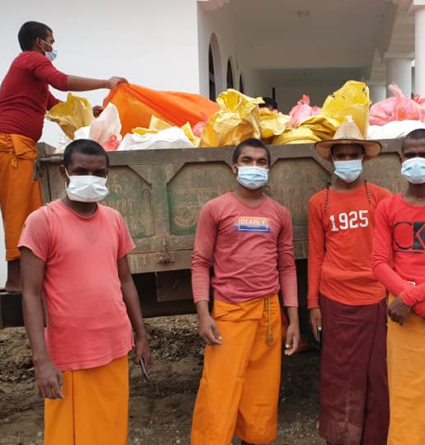

Slide 16
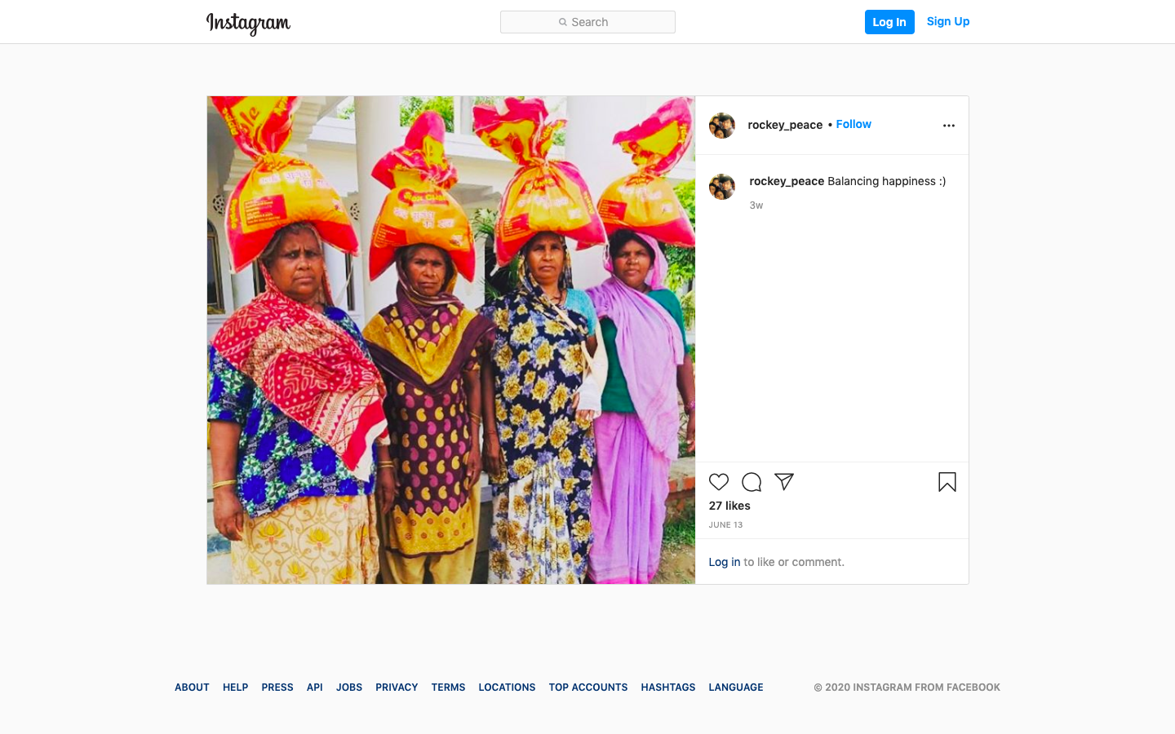

Slide 17
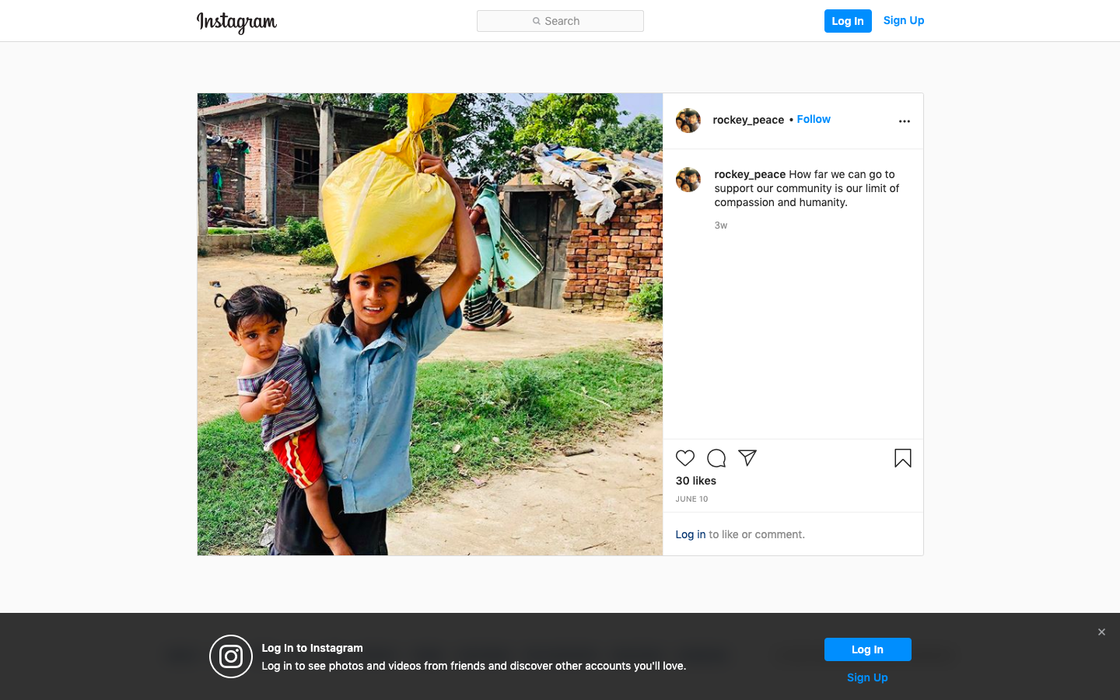

Slide 18
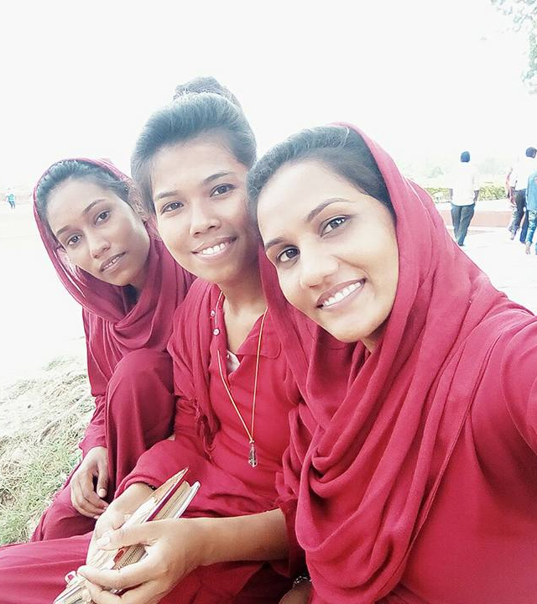

Slide 19
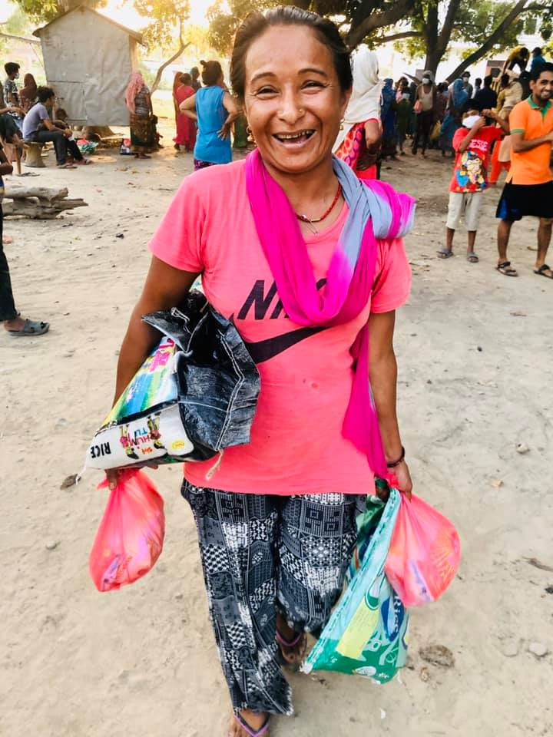
Response 3: critical and activist
“You cannot close your eyes and join your hands and pray for peace and harmony. You have to open your eyes and hands. You pay millions to make a statue, but nothing for people. The mega temples were a source of employment but now a source of suffering.”
Rockey Tripathi,
Lumbini Social Service Foundation and Bodhi Institute

Slide 20
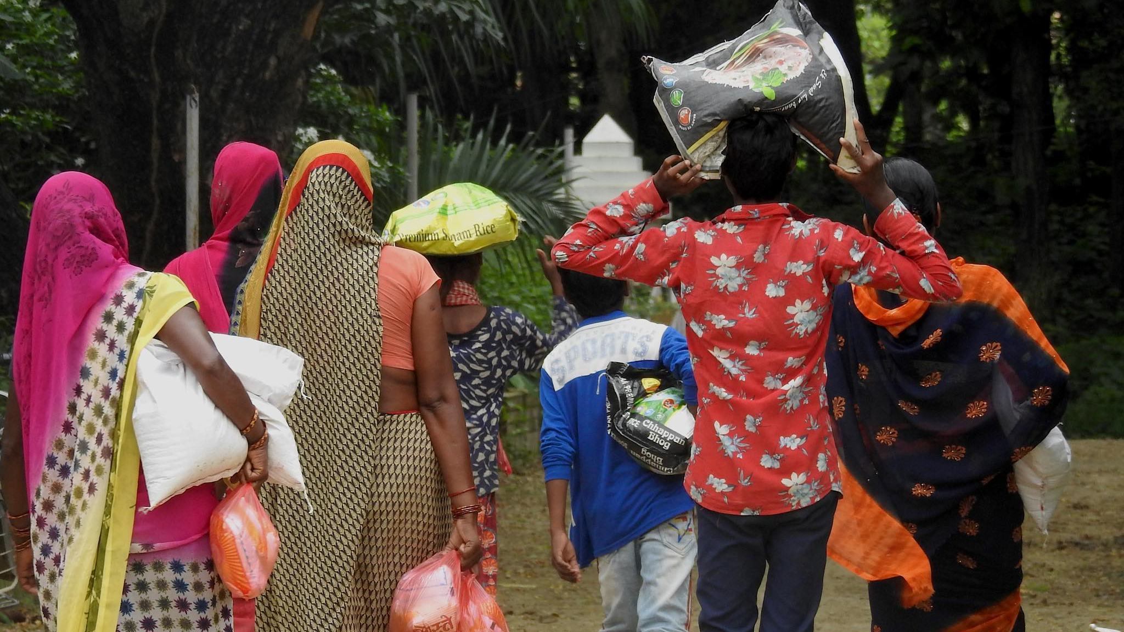
THANK YOU!

