Slide 1
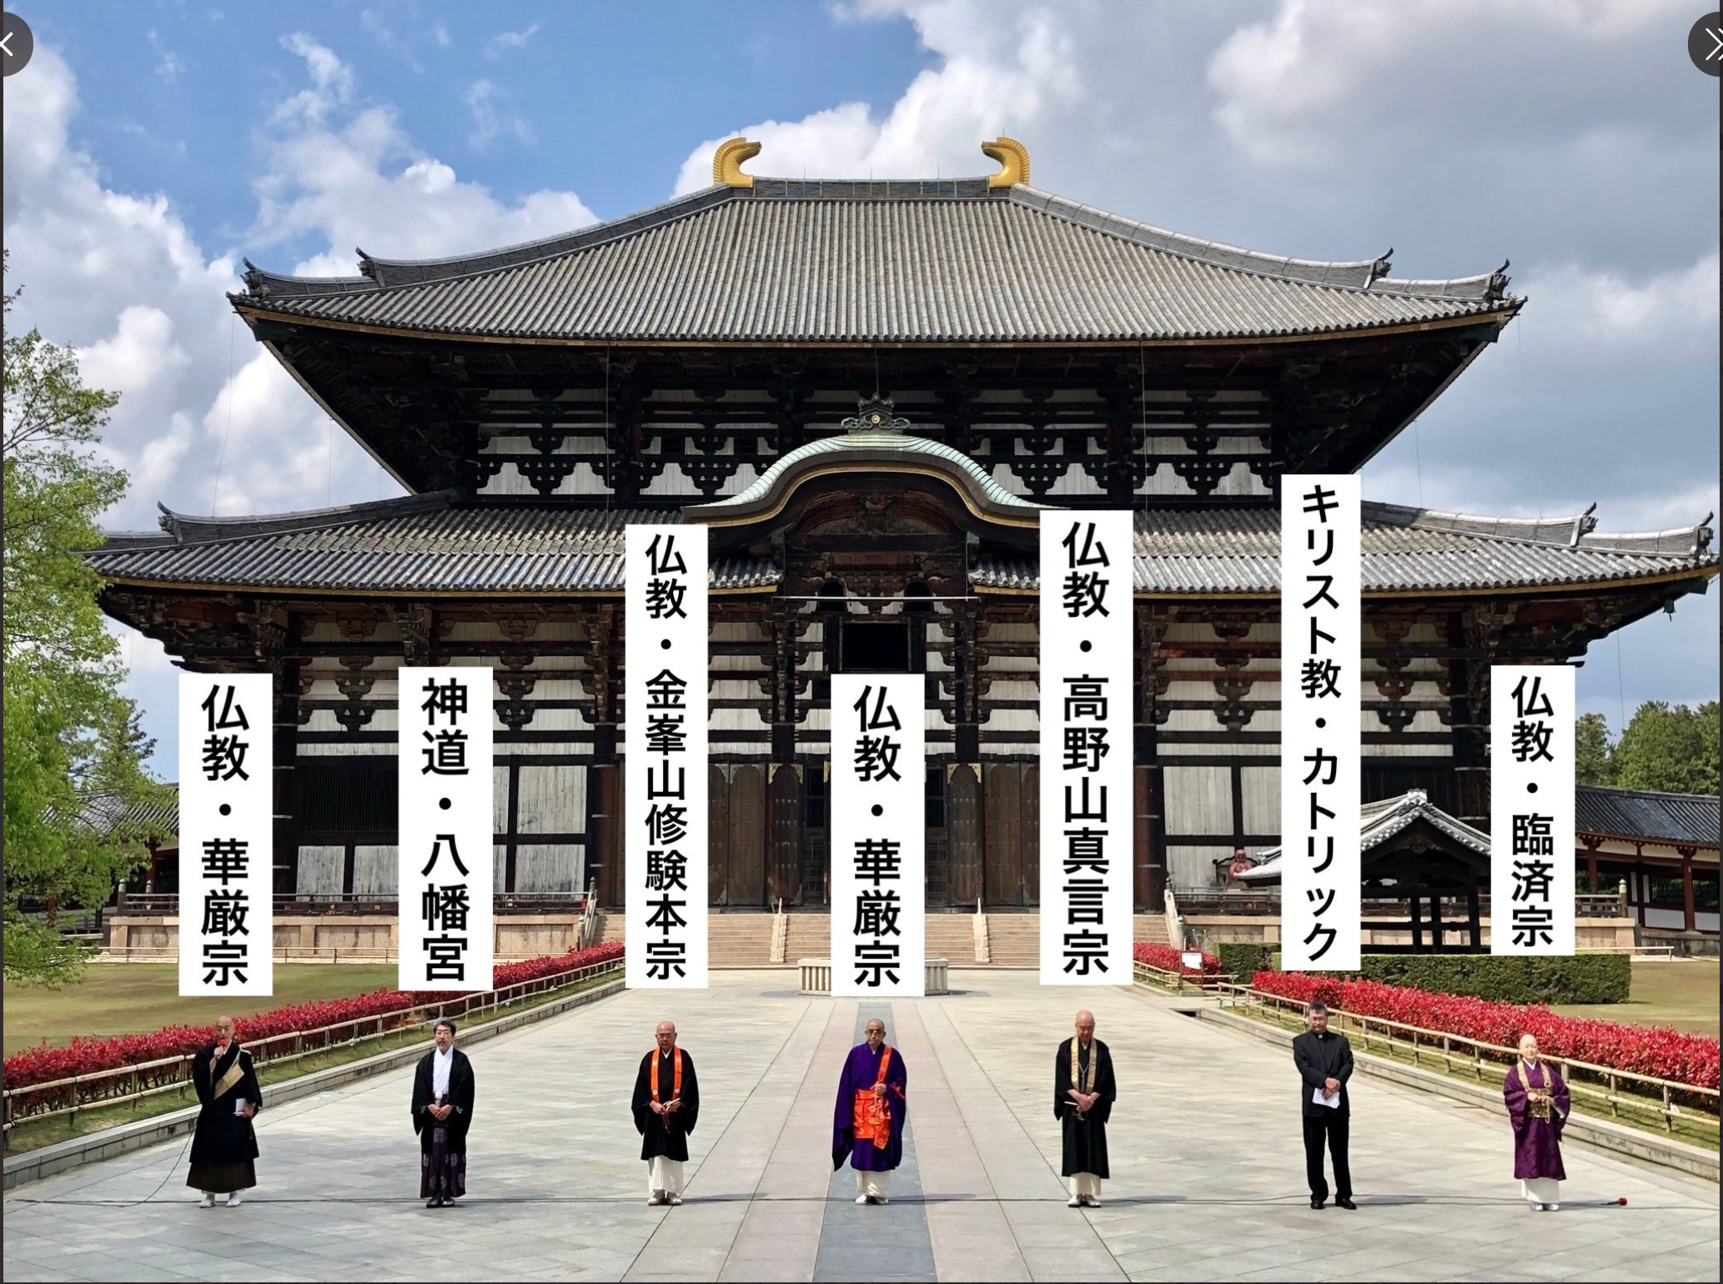
Buddhist responses to COVID-19 in Japan
Impacts on temples
Ritual responses
Social welfare engagement
Spillover effects: politics and popular culture
Representatives from Kegon, Shingon, and Rinzai Zen Buddhism; Shinto; Shugendō; and Catholicism stand in solidarity before the temple Tōdaiji in Nara on April 24, 2020, pledging to pray daily for a quick end to the pandemic and for those who died of COVID-19.
Levi McLaughlin
North Carolina State University

Slide 2
Severe impact on temple rituals and pastoral care for parishioners
Uneven use of technological means to overcome physical divides
Survey by Regional Planning Research Center, Taisho University (Tokyo)
Ad hoc streaming of funerals and memorial services to the bereaved.
Developing innovations by individual priests to broadcast meditation, chanting rituals, etc. via Facebook, Zoom, other platforms. Resulting in striking ecumenical innovations.
Sectarian HQs not equipped to provide technical support to temples. Relying on initiatives by outgoing priests.
Numerous clergy report that post-COVID-19 activities will see continued ritual innovation.
Examples in McLaughlin, Levi. 2020. “Japanese Religious Responses to COVID-19: A Preliminary Report.” The Asia-Pacific Journal: Japan Focus Vol. 18 Issue 9 No. 3 (May 1). https://apjjf.org/2020/9/McLaughlin.html
88.6% reported reduced numbers allowed at funerals.
87.8% canceled or delayed services at temples and homes.
Large majority of remaining services required special measures (masks, disinfectant, social distancing, reduced attendance).
Survey of 517 temple respondents between May 7 and 24, 2020, from ~12 denominations, publicized June 4, 2020.
https://chikouken.org/wp-content/uploads/2020/06/9cbedbddacbf235ad66bda66146d147c.pdf

Slide 3
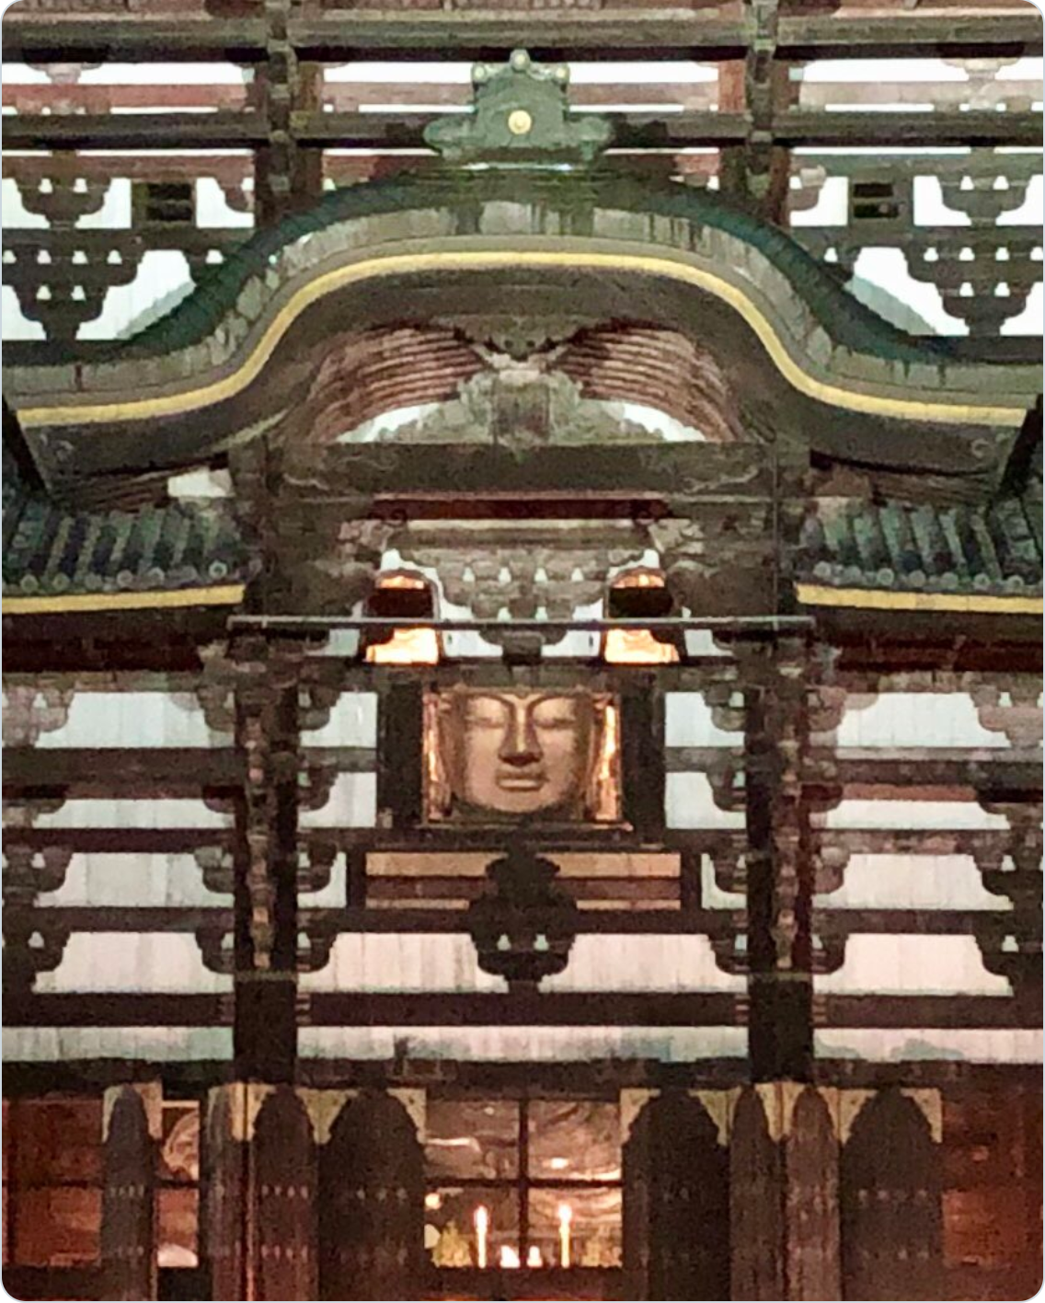
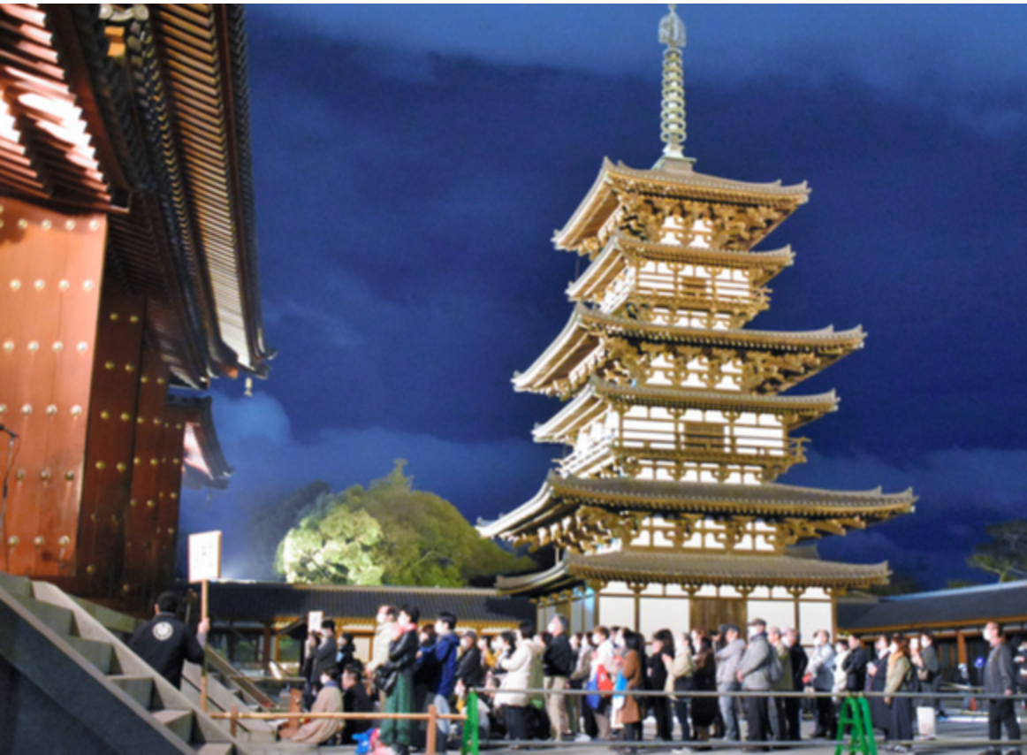
Ritual offerings: Japanese Buddhism as expunger of disease
Japan’s kokubunji: Buddhism as protector of the realm
The Buddhas reprise their roles as protectors against disease
Buddhism integral to Japan’s earliest governmental systems.
Establishment of the kokubunji system, sponsoring monasteries and convents in all of the provinces, linked to a smallpox epidemic of the 730s.
Reverence for the Buddhas linked to deliverance from calamity; calamity equated with failure on the part of the sovereign and the populace to fulfil ethical obligations, including taking refuge in the three treasures.
See Lowe, Bryan. 2020. “Protection without Punishment: Turning to the Buddhist Gods during COVID-19.” The Immanent Frame (June 25). https://tif.ssrc.org/2020/06/25/protection-without-punishment/
The 15-meter Buddha Vairocana at the temple Tōdaiji gazes out through a rarely-opened portal to protect the people of the realm.

Slide 4
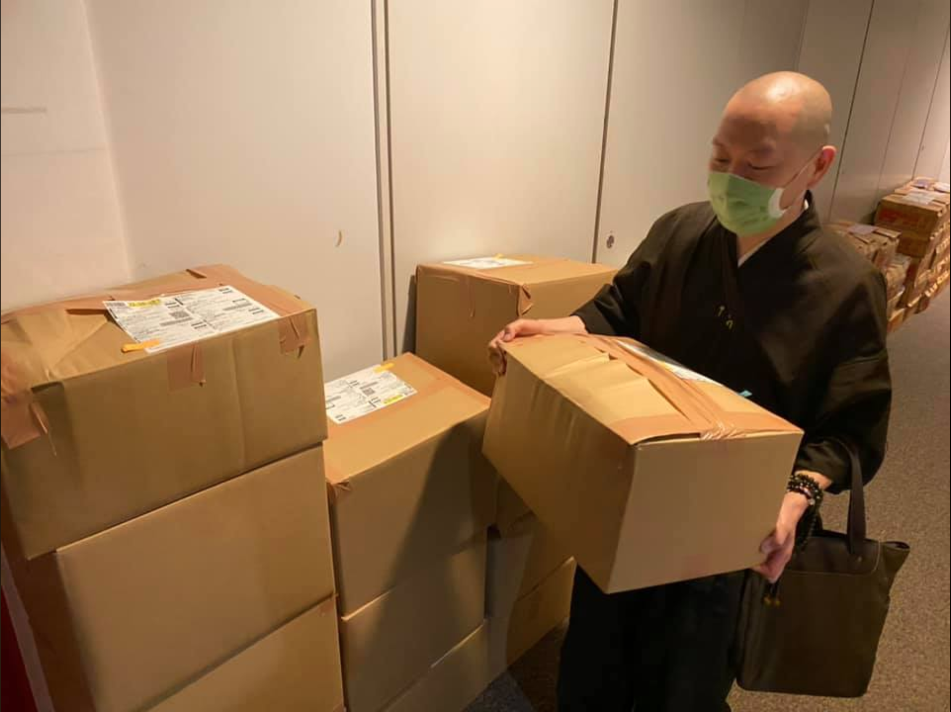
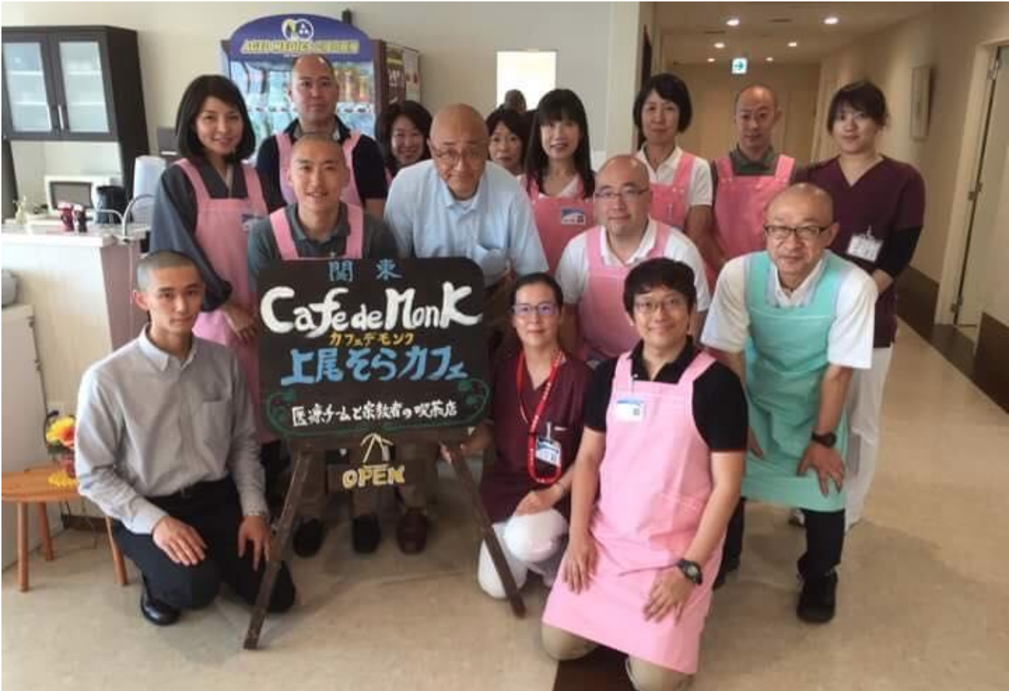
Caring for the marginalized: Buddhist social welfare
COVID-19 presents outreach programs with unprecedented challenges
Ongoing initiatives
Hitosaji no Kai (Single Spoonful Association)
https://www.facebook.com/hitosajinokai
http://www.asahi.com/ajw/articles/13523578
Rinshō Shūkyōshi (Interfaith Chaplaincy)
http://www2.sal.tohoku.ac.jp/p-religion/2017/cn8/pg27.html
How to mobilize aid when the government calls for “self-restraint” (jishuku)?
How to address new housing challenges as businesses close?
How to connect with marginalized populations (migrants, the homeless, others) that suffer disproportionately during sudden economic downturn?
How to serve in hospitals, palliative care, and other clinical settings during a medical emergency?

Slide 5
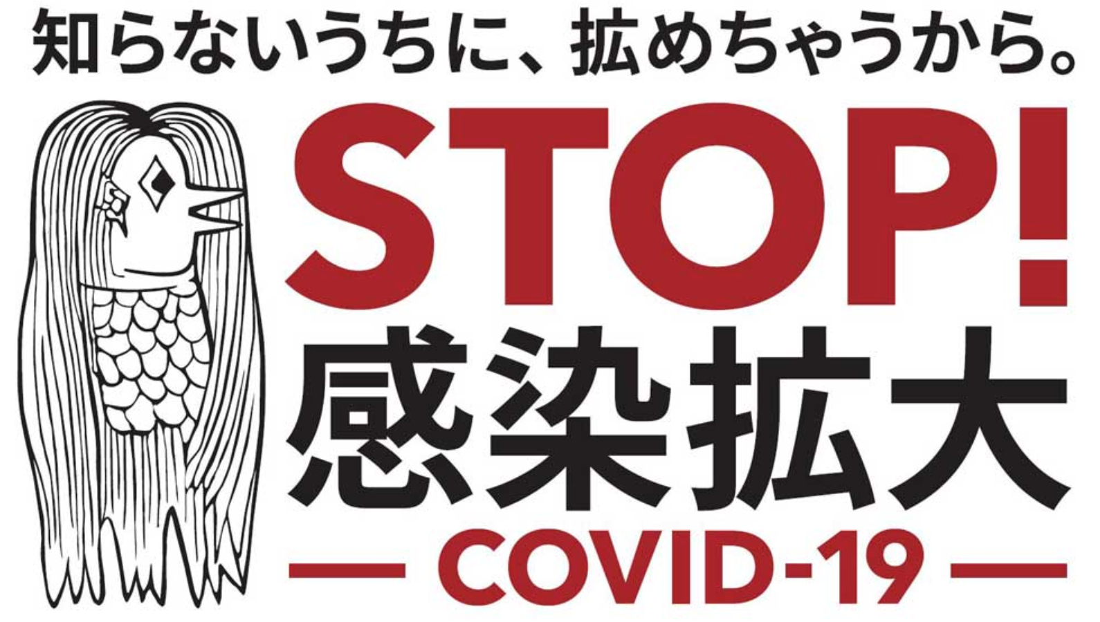
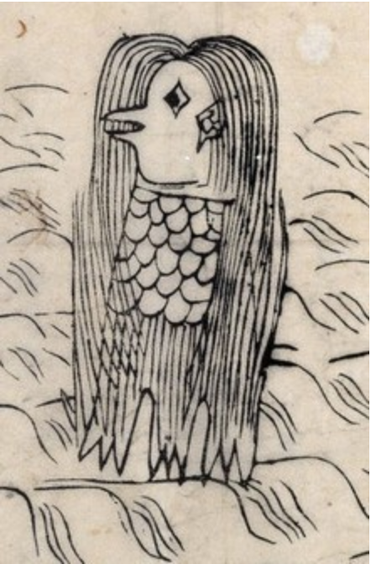
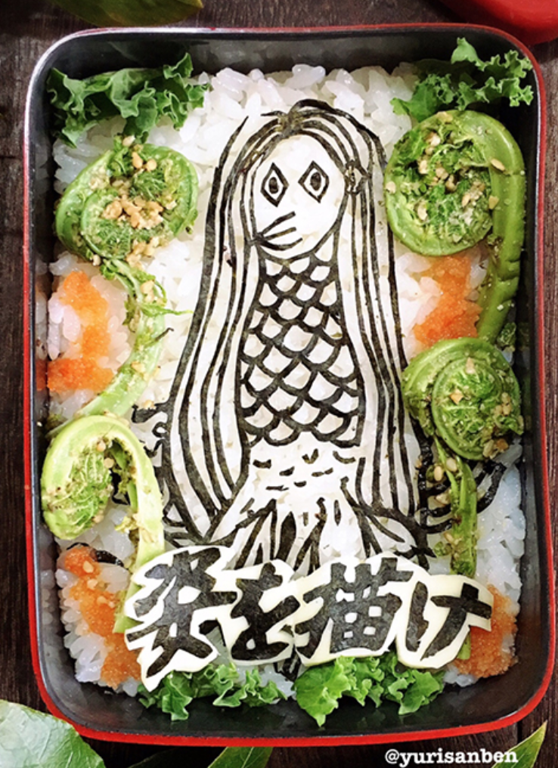

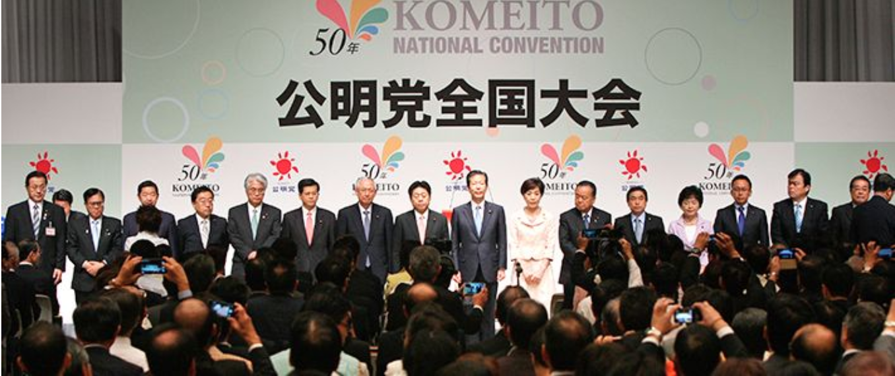
Beyond the temple: wide-ranging effects in the Buddhist world
Soka Gakkai electoral mobilization
A return to Japan’s bestiary: the amabie
Nichiren Buddhism-based lay association supports Komeito, junior partner in Japan’s national coalition allied with the Liberal Democratic Party (LDP).
Most potent vote-gathering bloc.
Soka Gakkai shut down operations in mid-February, will not resume meetings in districts until late July / early August.
LDP pushing for snap election in fall 2020. Komeito / Soka Gakkai are opposed to this plan.
Part of ongoing intra-coalition conflict between LDP and Komeito.
COVID-19 could see marginalizing of Buddhism-founded party in national-level Japanese politics.
https://www3.nhk.or.jp/nhkworld/en/news/backstories/1117/
https://mainichi.jp/english/articles/20200707/p2a/00m/0na/010000c

