Slide 1
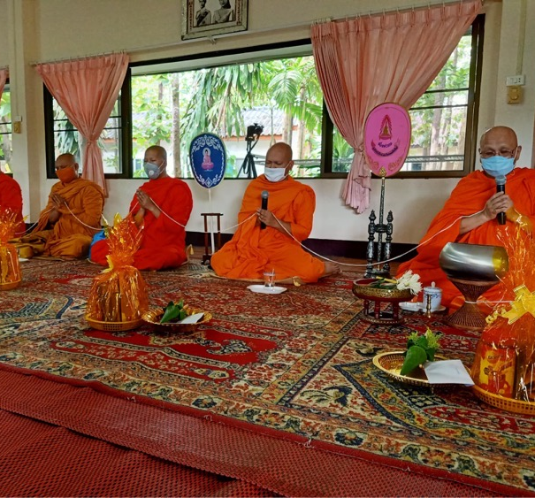
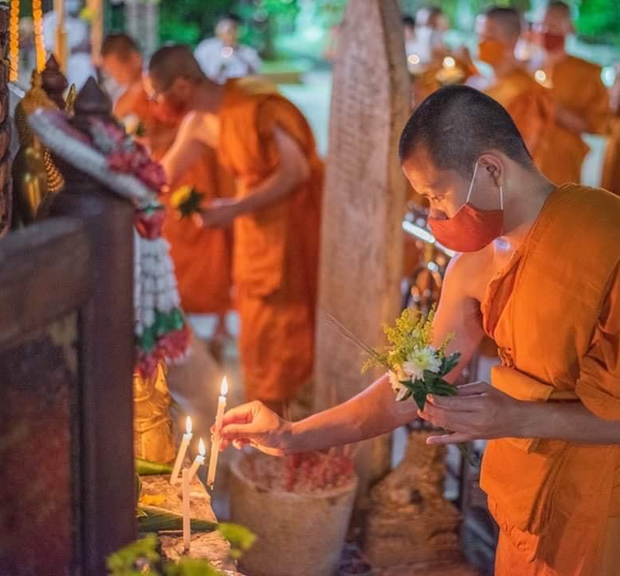
Thai Buddhist Responses to Covid-19
Brooke Schedneck, Rhodes College

Slide 2
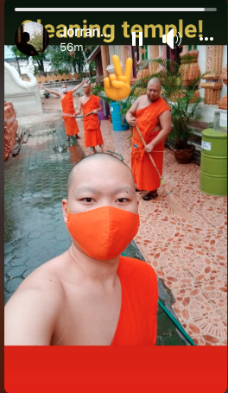
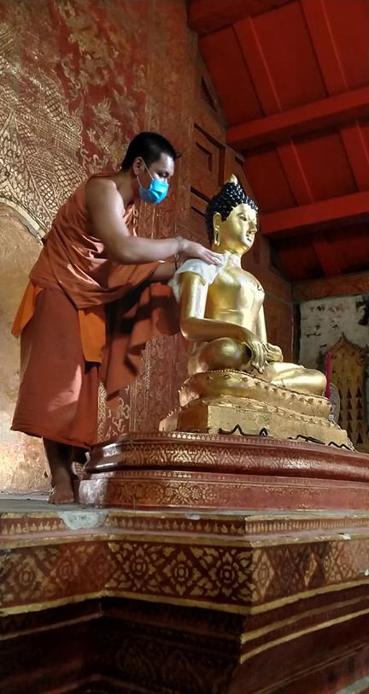
Cleaning the Temple

Slide 3
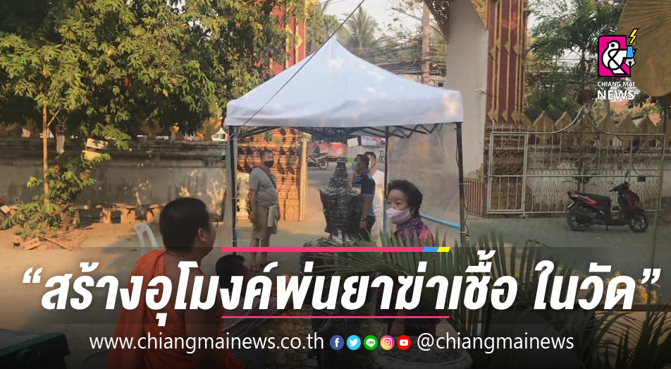
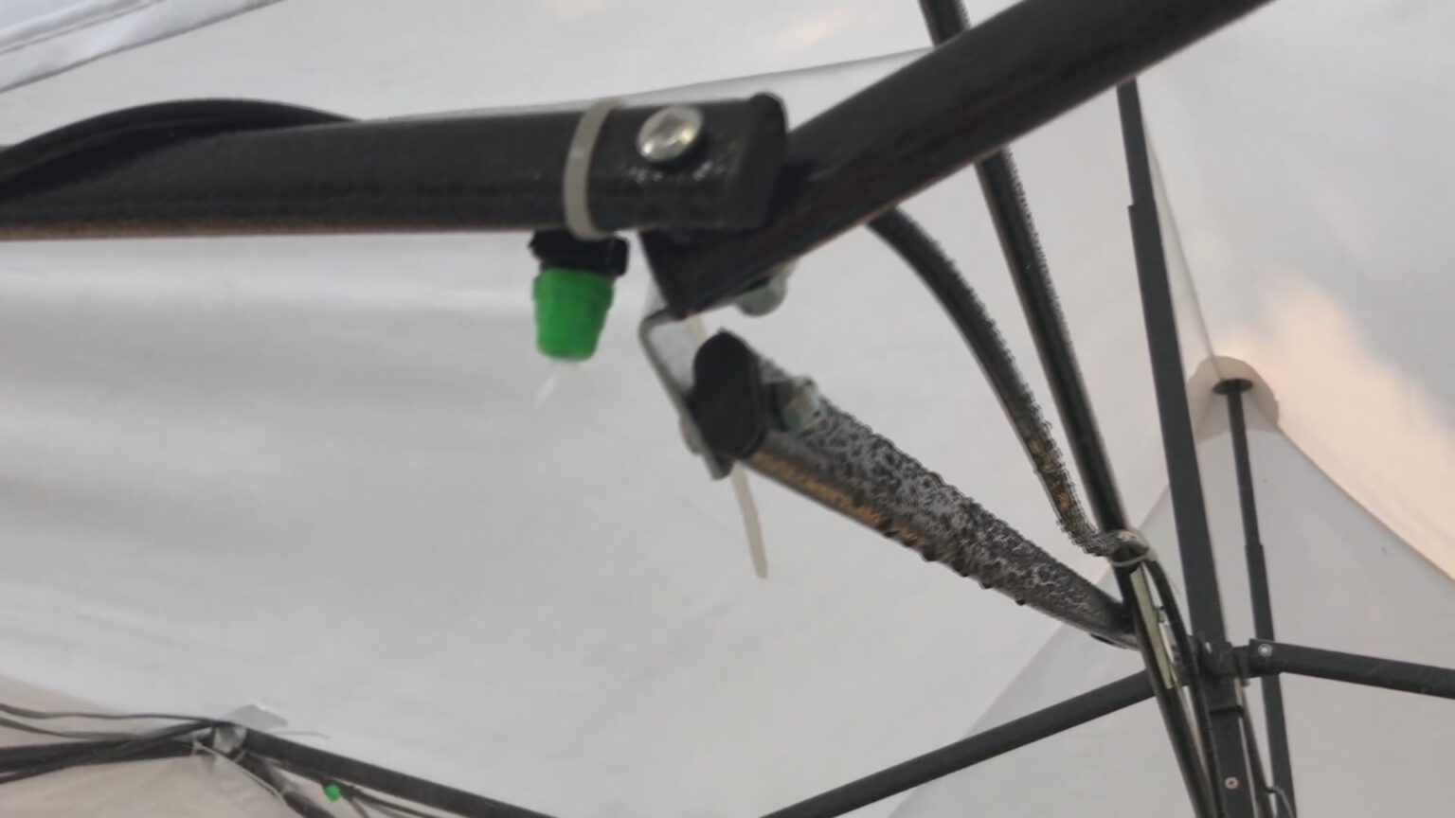
Temple Safety: Sanitizing Merit-Making
https://www.chiangmainews.co.th/page/archives/1315030/
https://news.trueid.net/detail/dQlDm6BOmdoQ

Slide 4
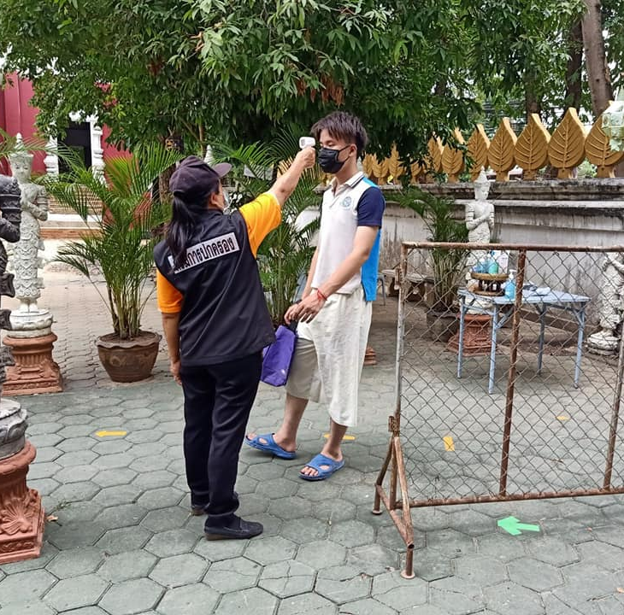
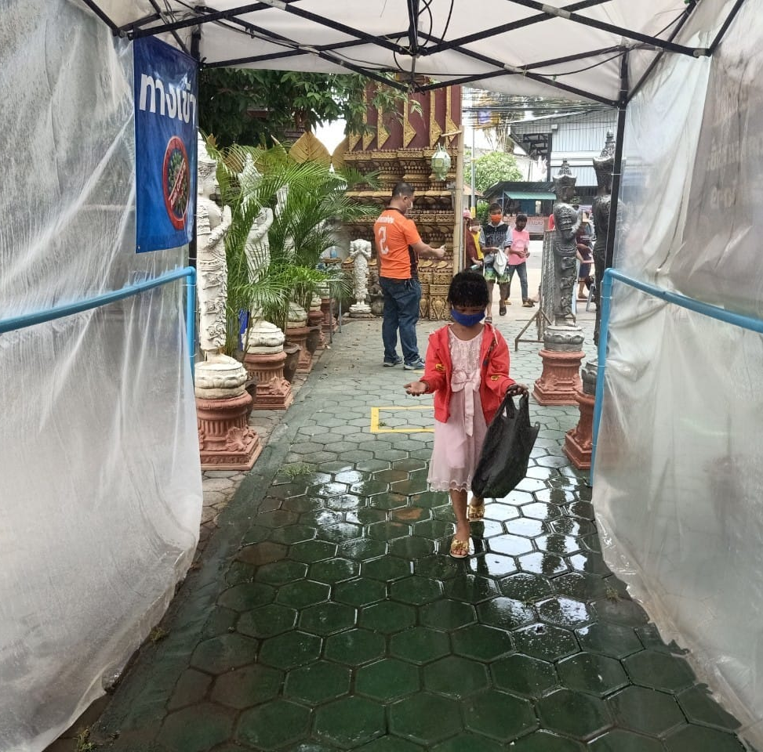
Keeping the Temple Safe
Disinfectant and temperature checks

Slide 5
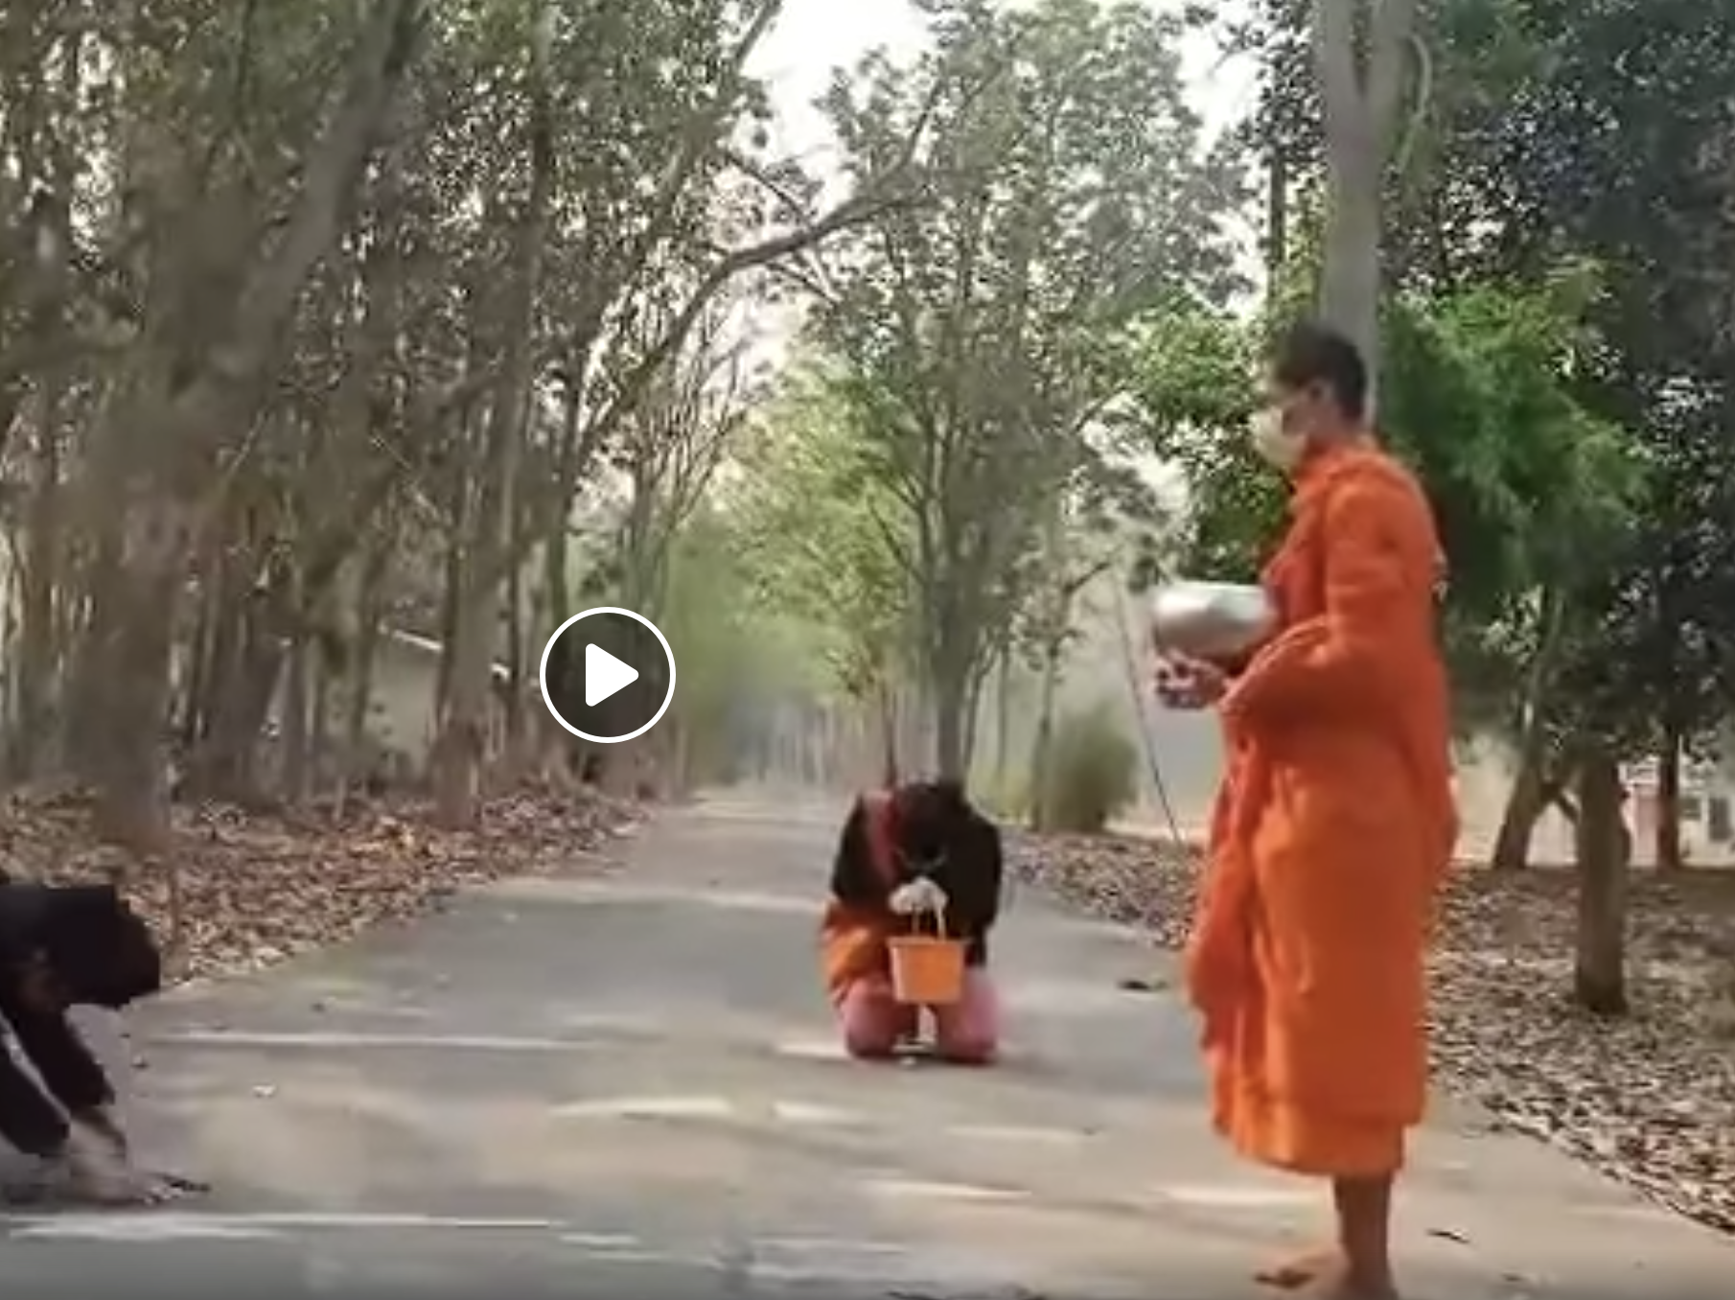
Socially Distant Merit-Making
https://www.facebook.com/sotana.sotana.31/videos/552855882290021/

Slide 6
Helping the Community- making free masks
https://www.sanook.com/news/8047806/

Slide 7
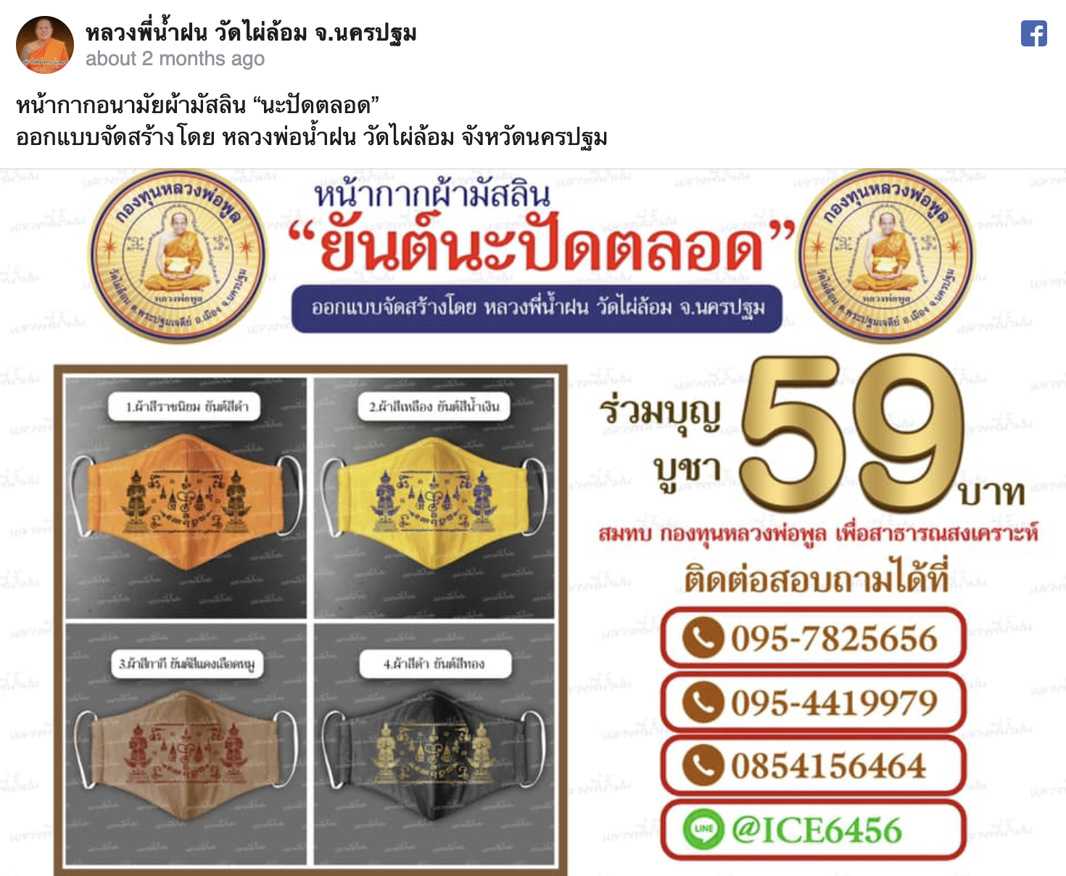
Commodifying Buddhist Protection
https://thethaiger.com/thai/news-th/thailand-th/สุดเท่-หน้ากากอนามัยลงย

Slide 8
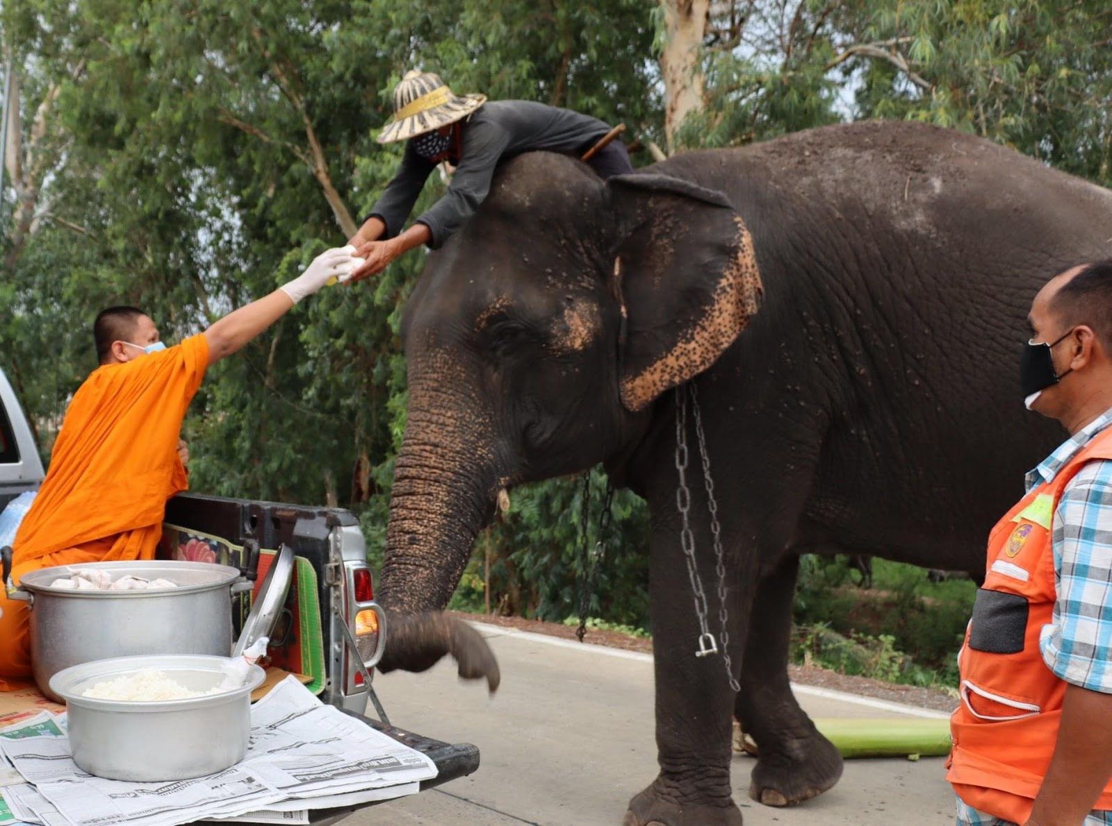
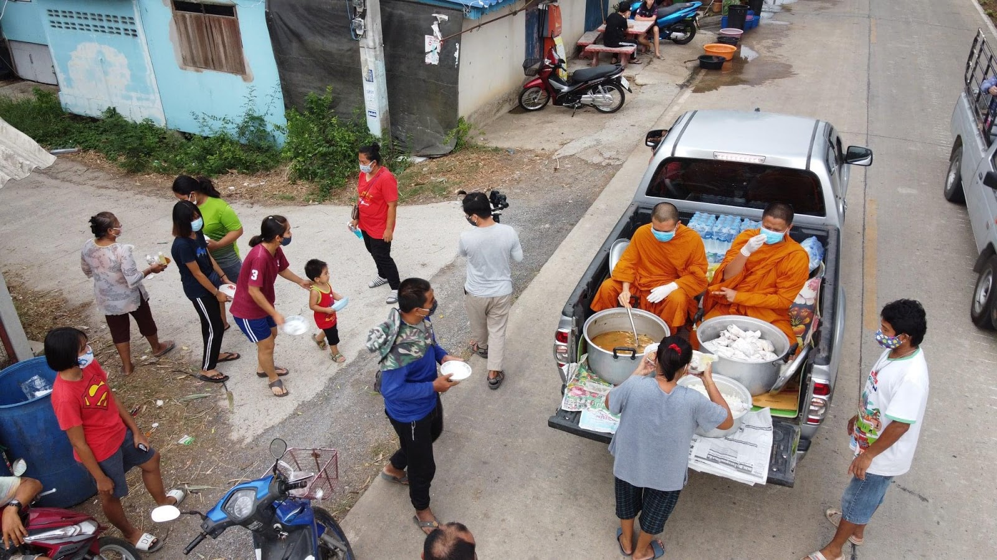
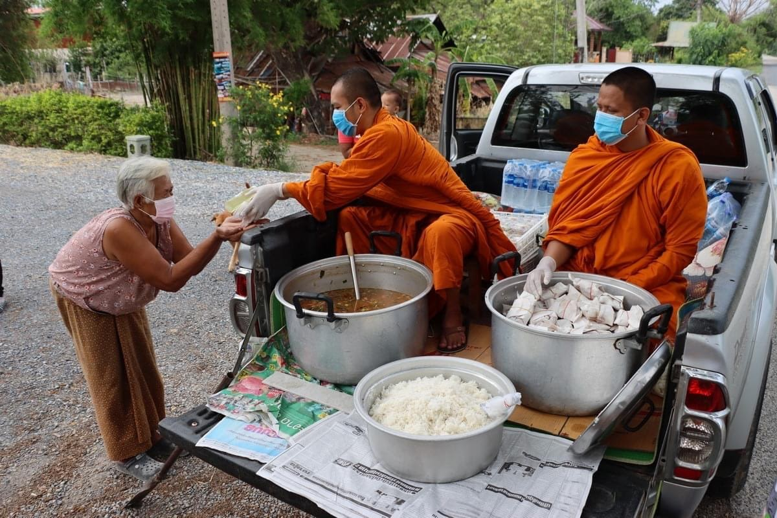
Helping the Community: Giving food

Slide 9
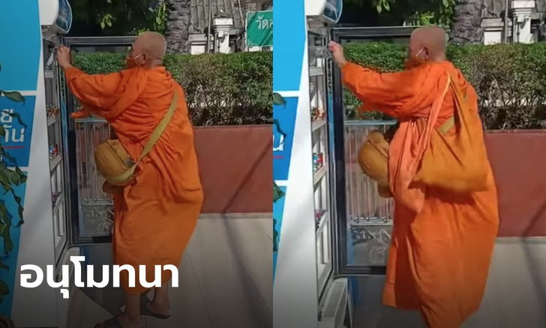
Giving always alms food collection https://www.sanook.com/news/8148870/

Slide 10
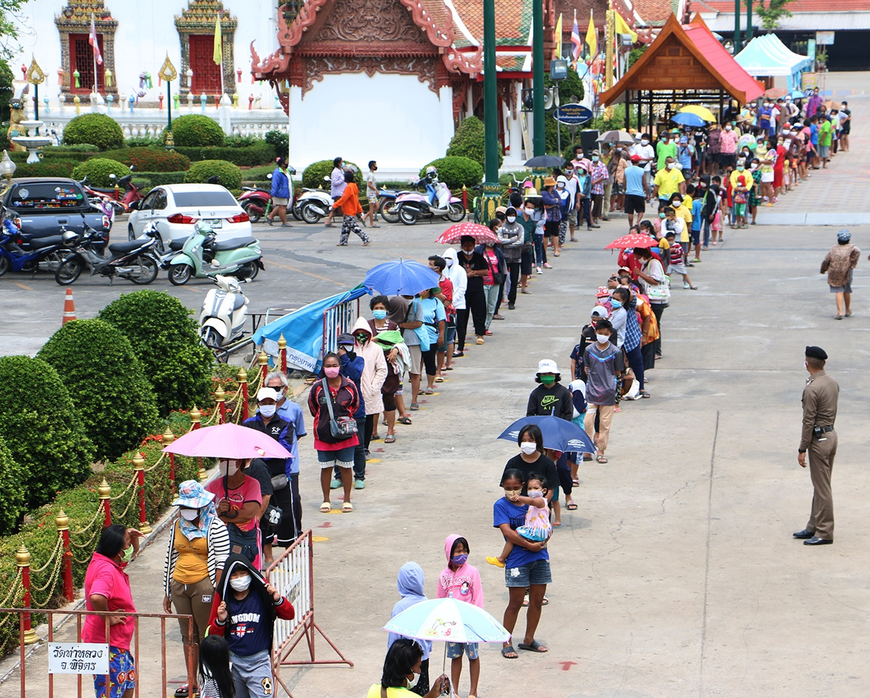
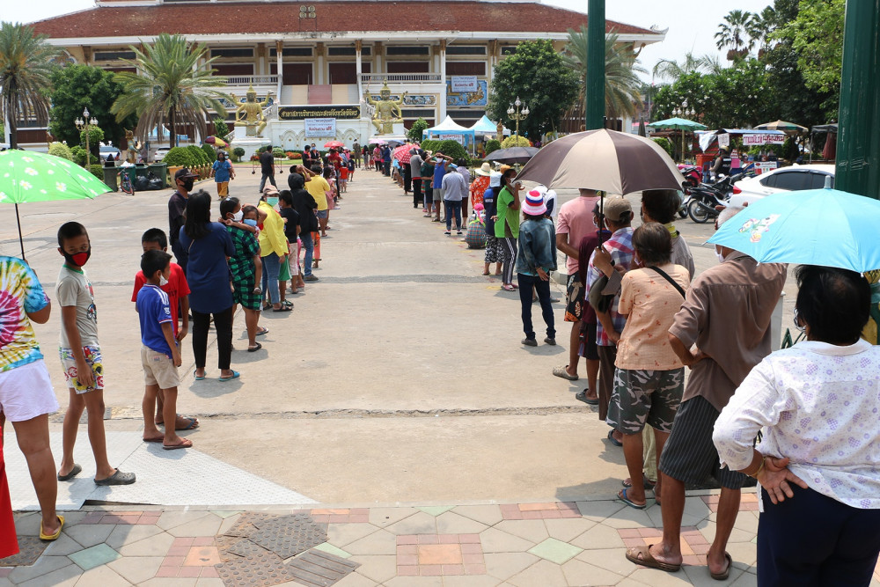
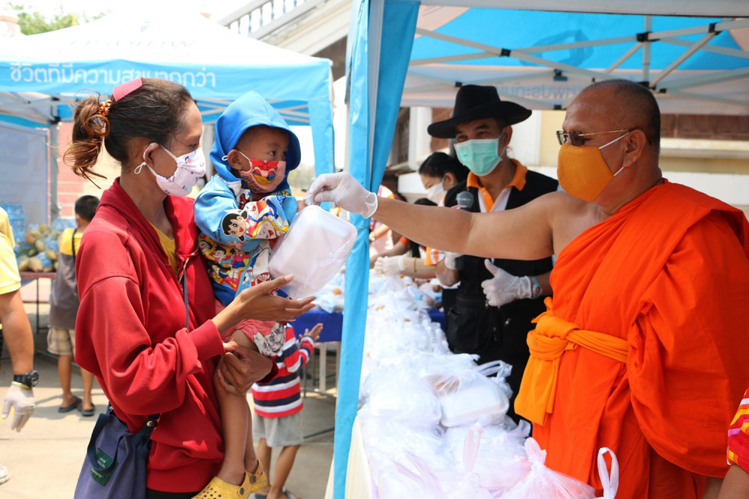
Providing meals everyday https://www.posttoday.com/social/local/621055

Slide 11
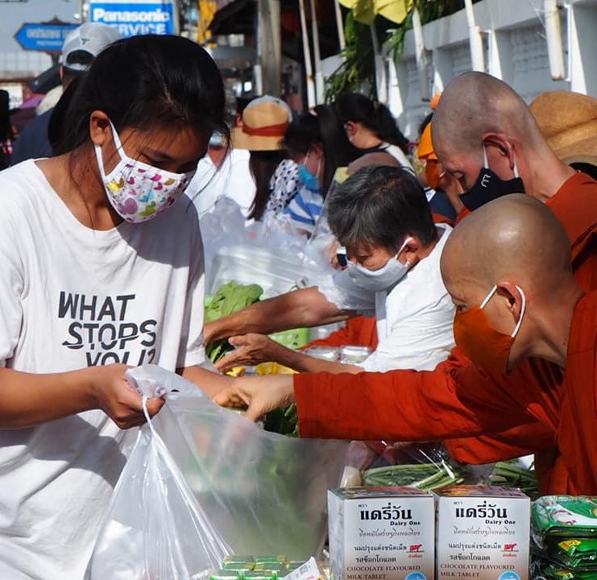
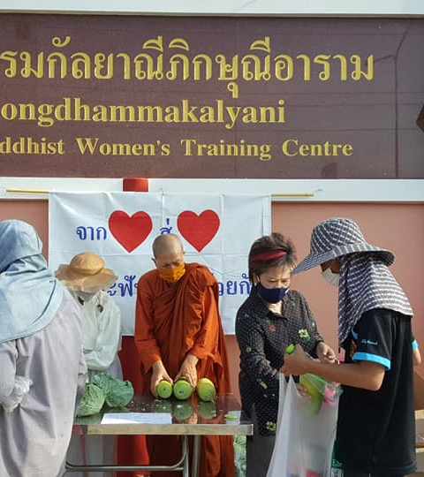
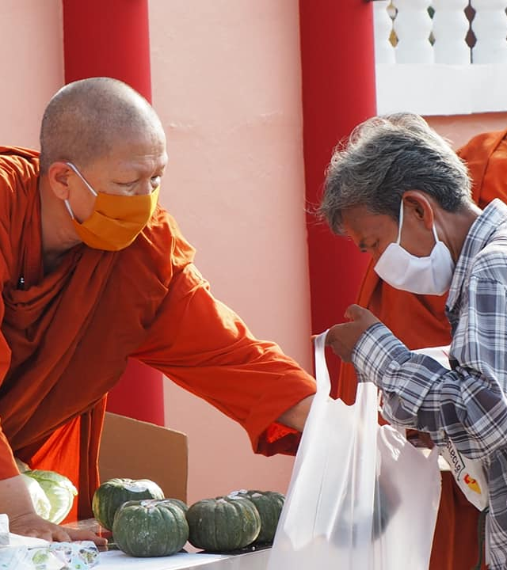
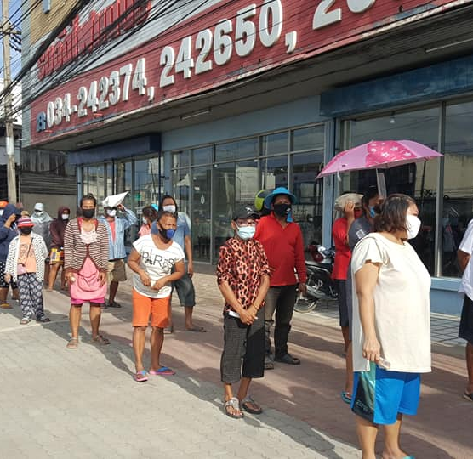
Dhammananda Bhikkhuni serving her community (https://www.matichonweekly.com/column/article_305406)

Slide 12
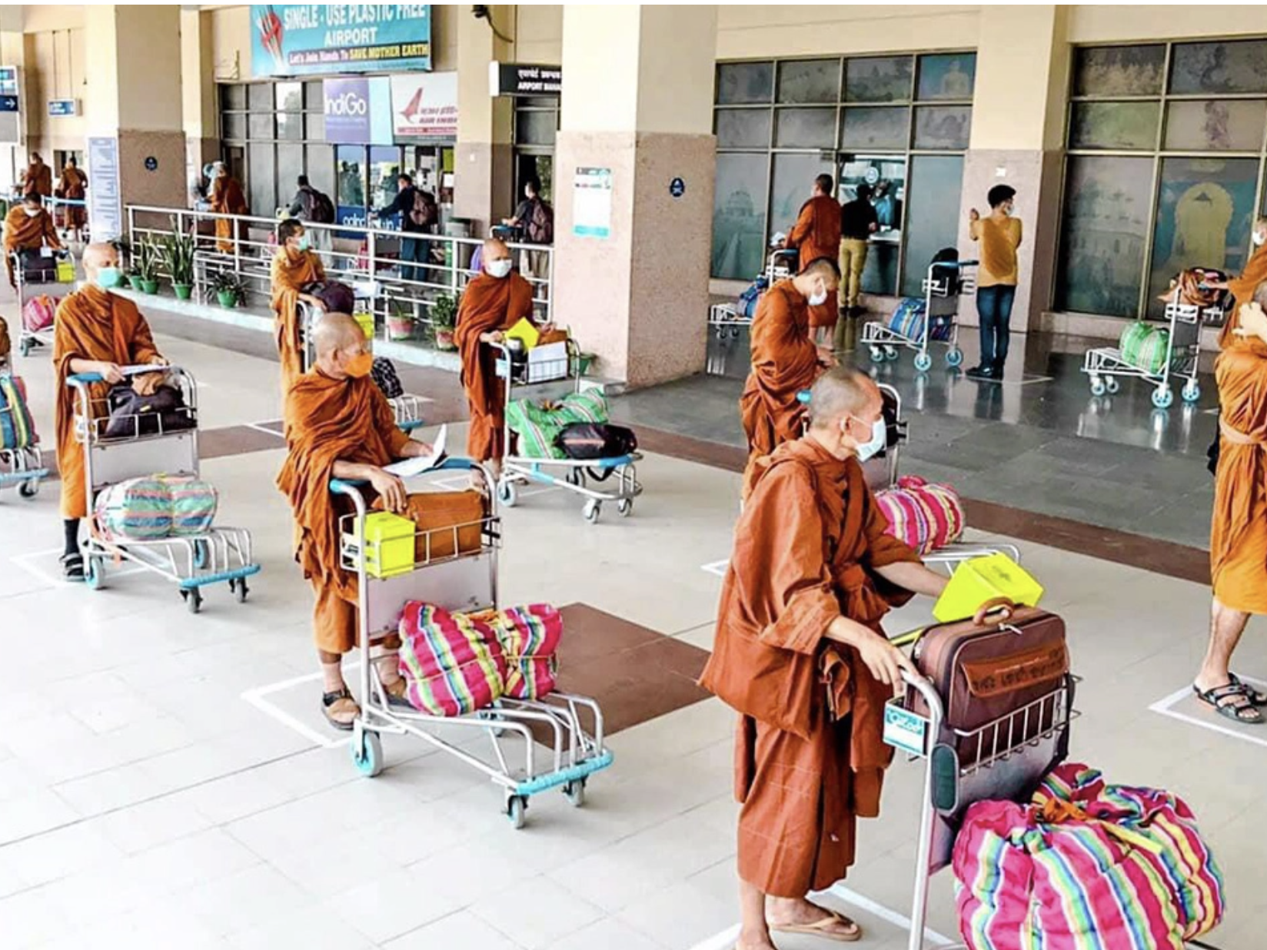
Quarantine Issues: Monks in Hotels? https://www.thairath.co.th/news/society/1831351

Slide 13
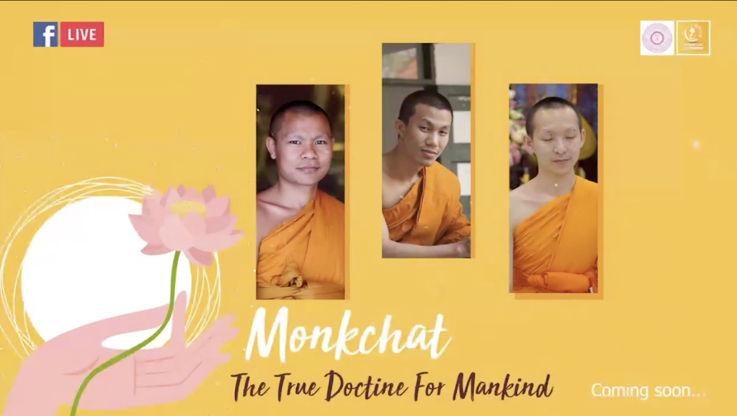
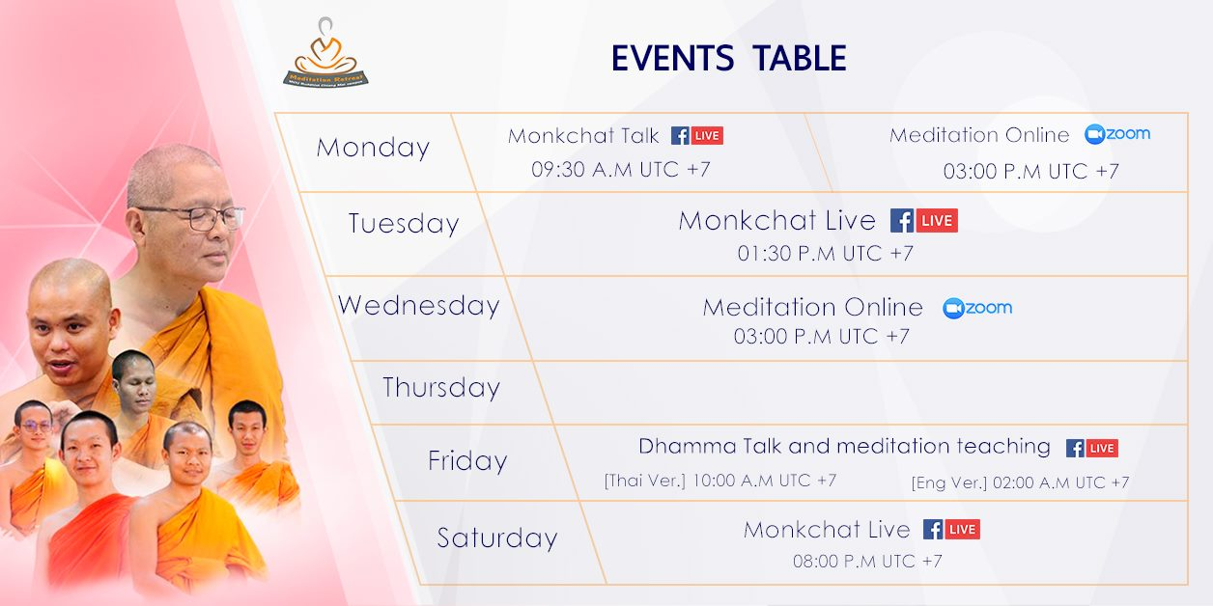
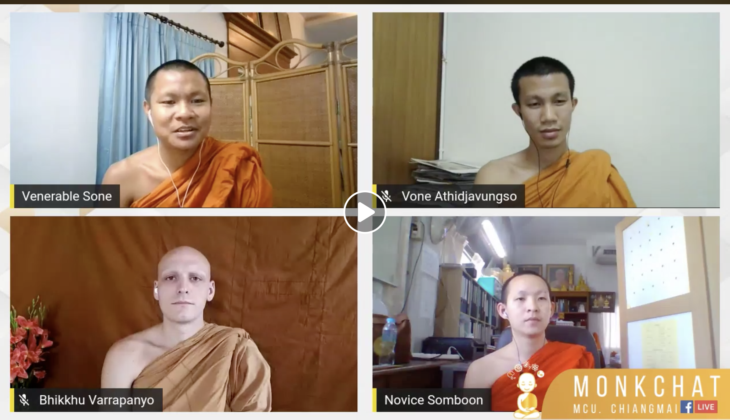
Reaching out virtually https://www.facebook.com/TH.MRLearning/

Slide 14
Summary- adaptations to Thai Buddhism during Covid-19
Reaching out virtually
Serving the international and Thai communities with Q&A and meditation online
Temple space
Cleaning, disinfecting, social distancing, providing masks, facilitating merit-making
Monks
Some discussion about their actions
Mostly Socially Engaged Buddhist
Redistributing the economy of merit

