Slide 1
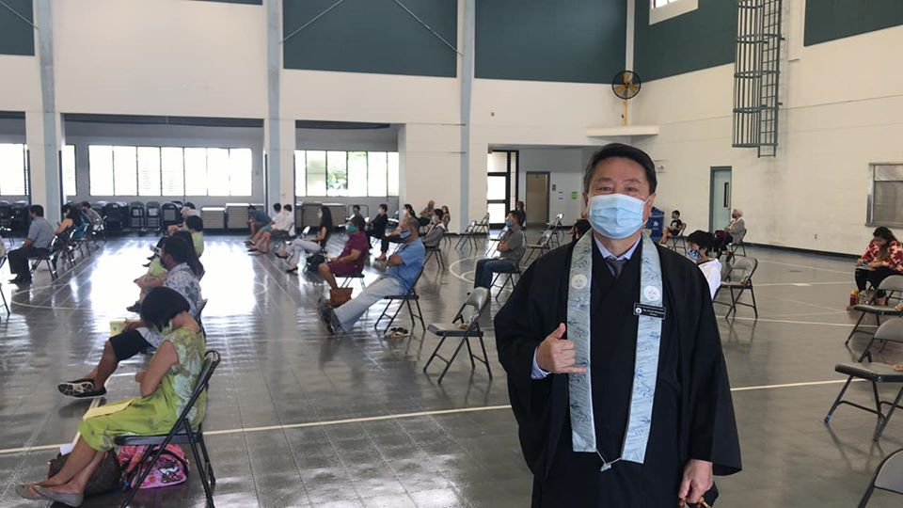
“Six feet apart we’re closer than ever” Buddhism in Canada and the United States During the Pandemic

Slide 2
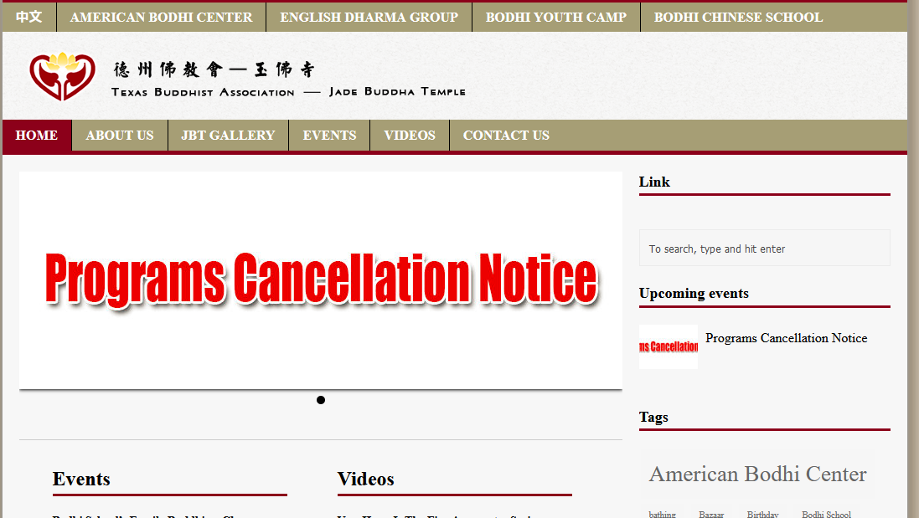

Slide 3
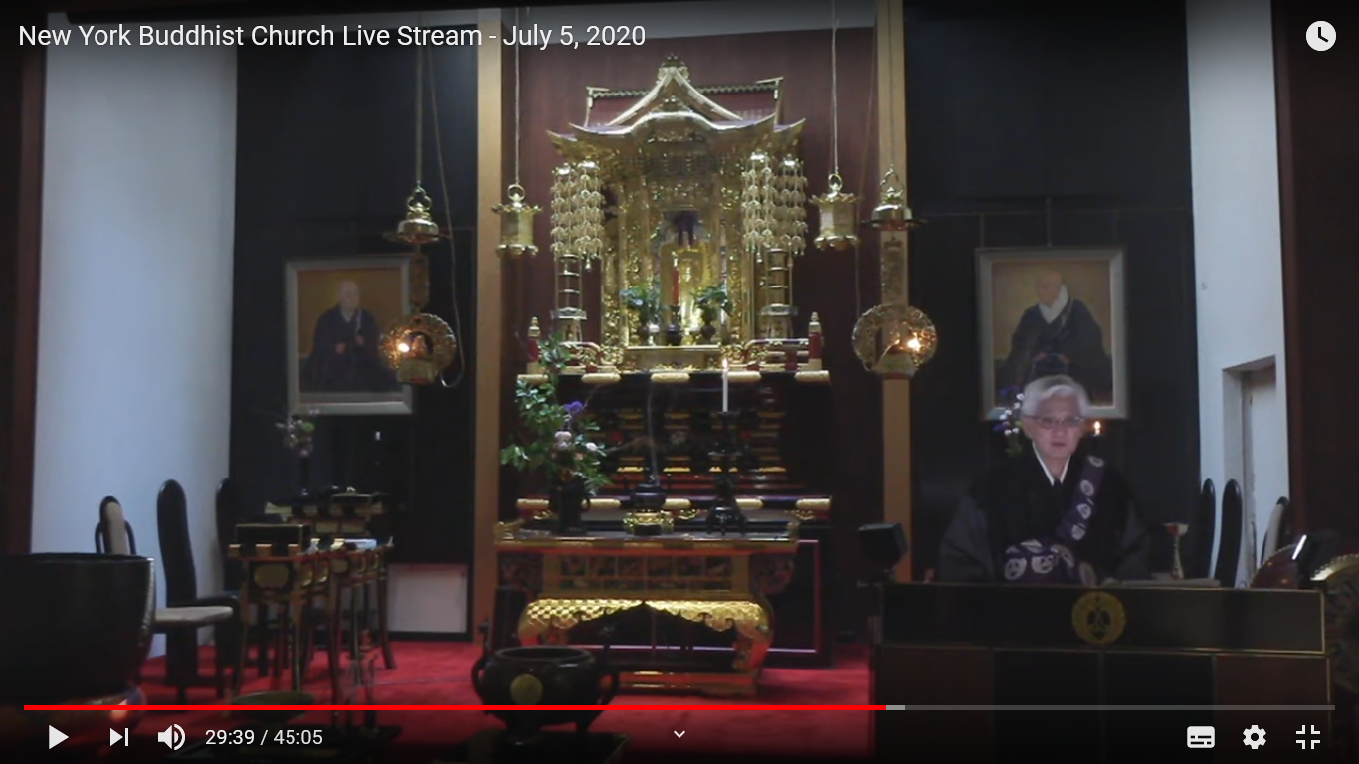

Slide 4
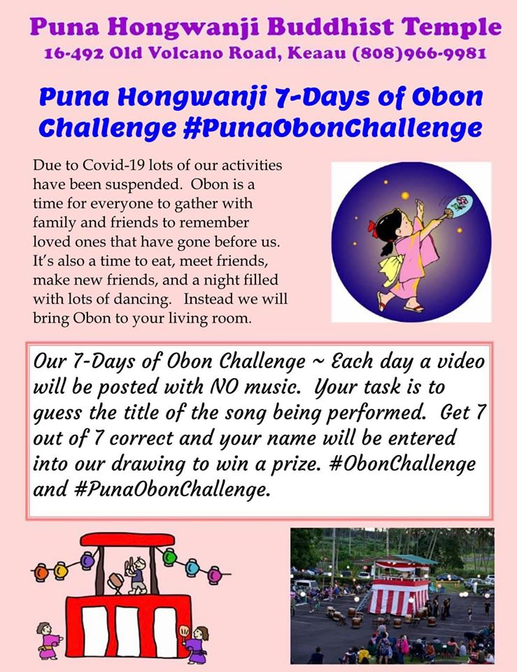
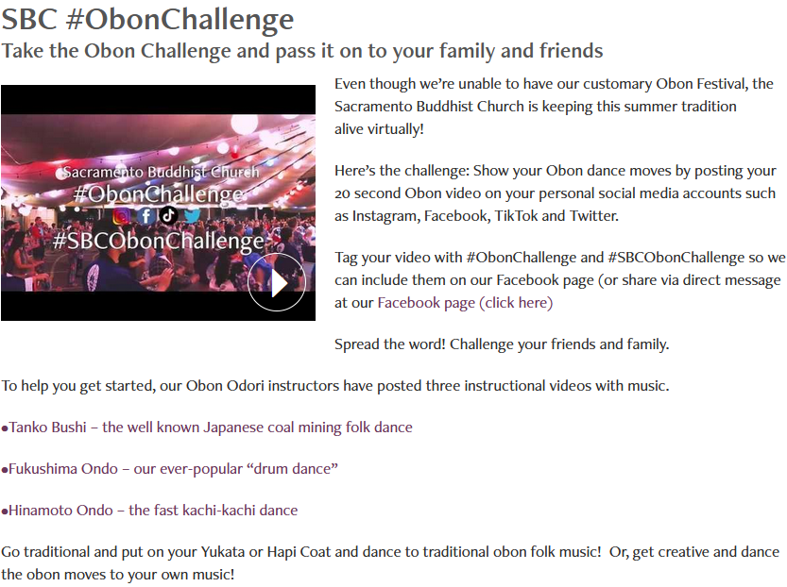

Slide 5
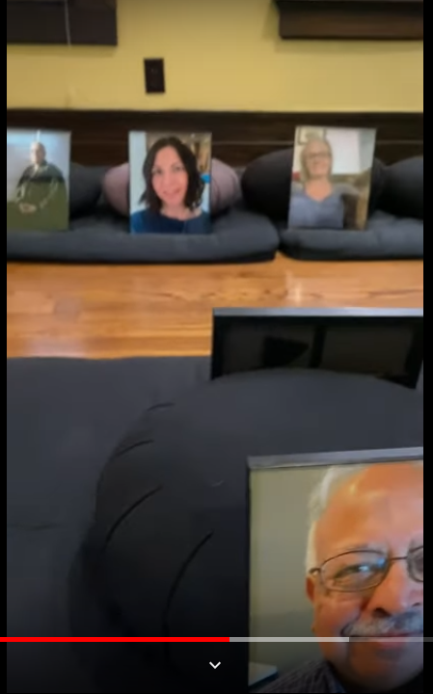
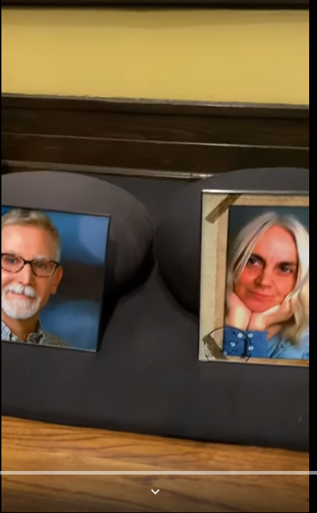
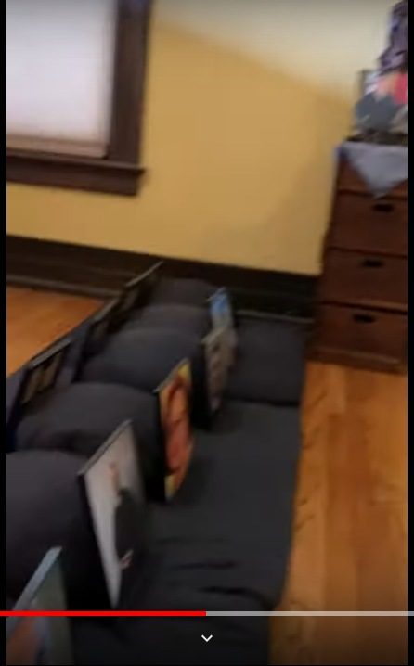
Houston Zen Center YouTube Channel

Slide 6
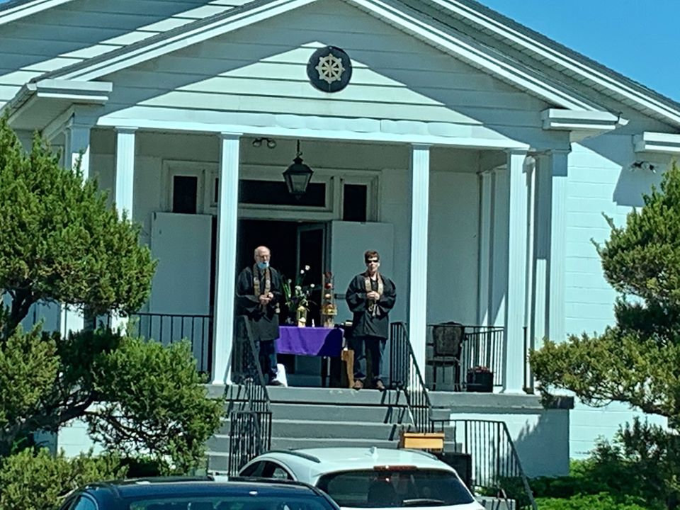
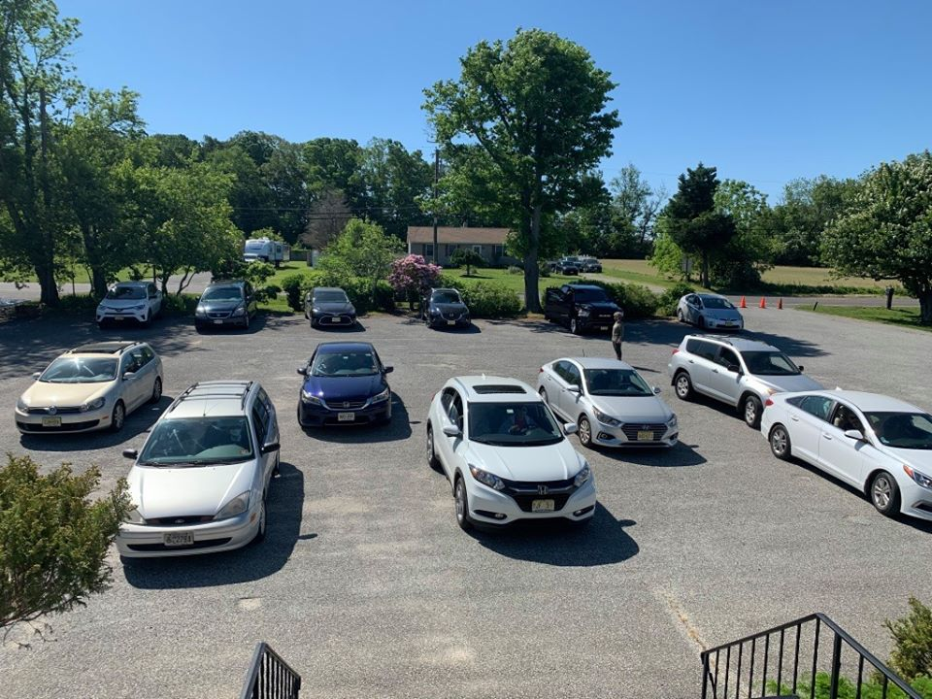
Parking lot service in front of rural New Jersey temple (Seabrook Buddhist Temple Facebook)

Slide 7
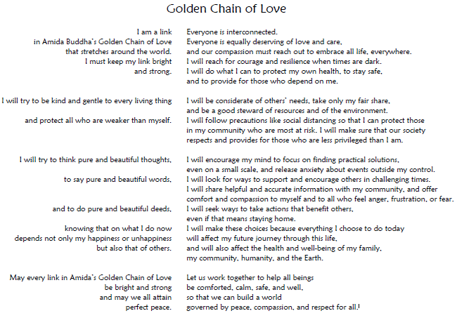
Reflection by Benjamin Bruch, Pacific Buddhist Academy

Slide 8
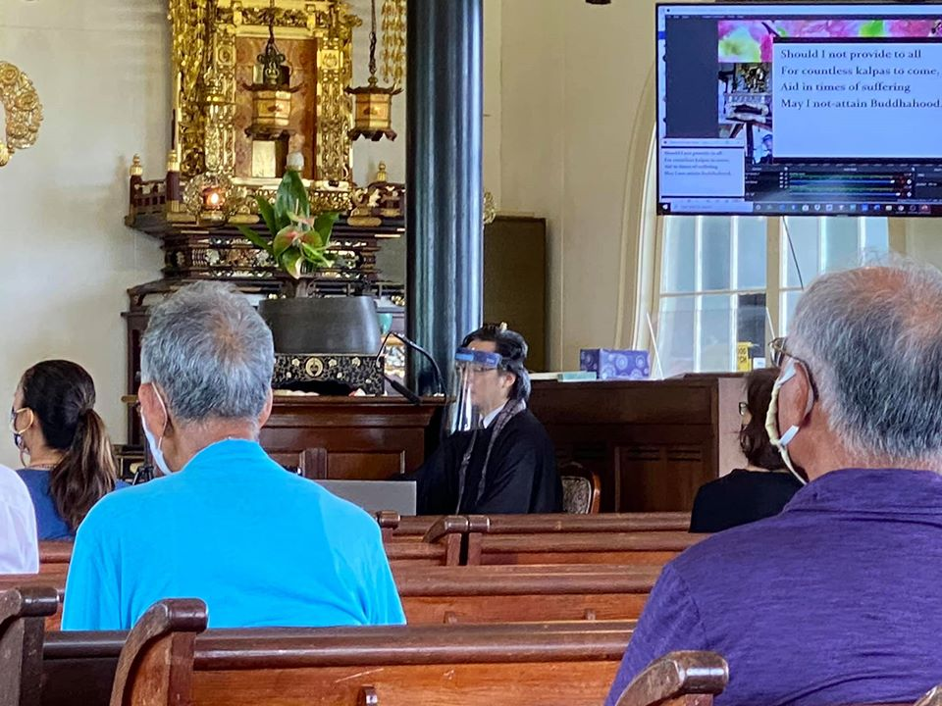
Puna Hongwanji new rules
Monk with face-shield
Masked laymembers
One person per pew
No chanting or singing by congregation
No incense offering by congregation
Screen-projected liturgy (no service books)
Pre-reserved seating
Health check at door
Hand-sanitizing station
No post-service meal
One-way traffic flow in worship hall
No car-pooling to temple

Slide 9
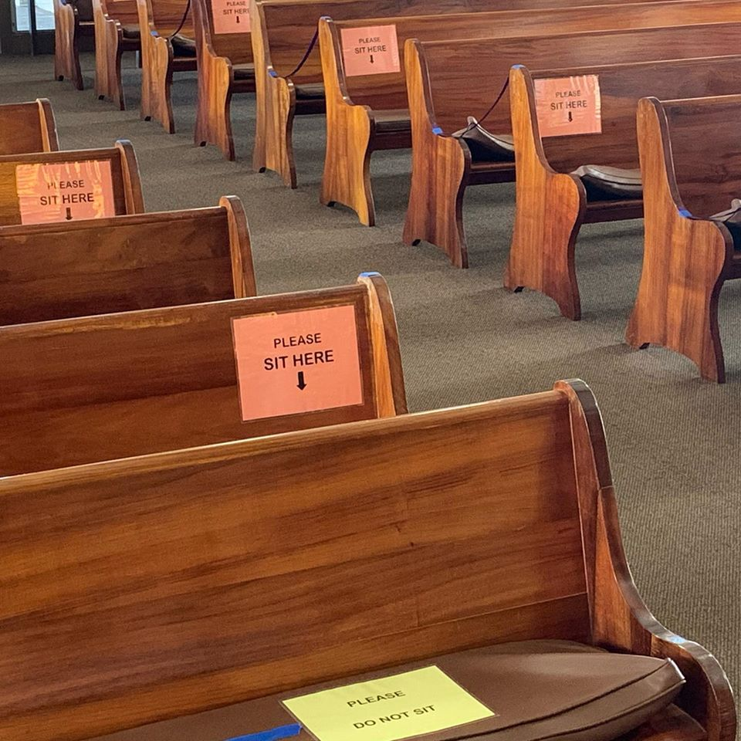
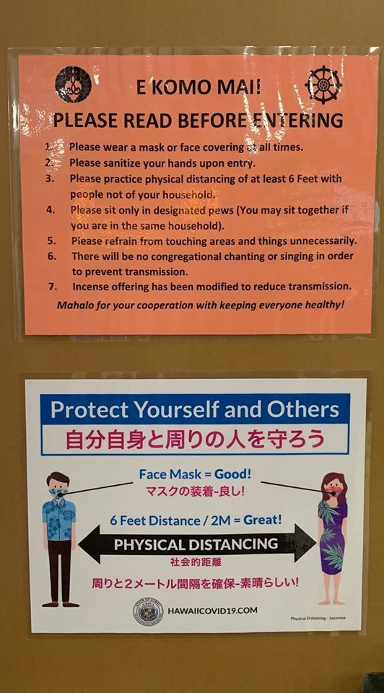
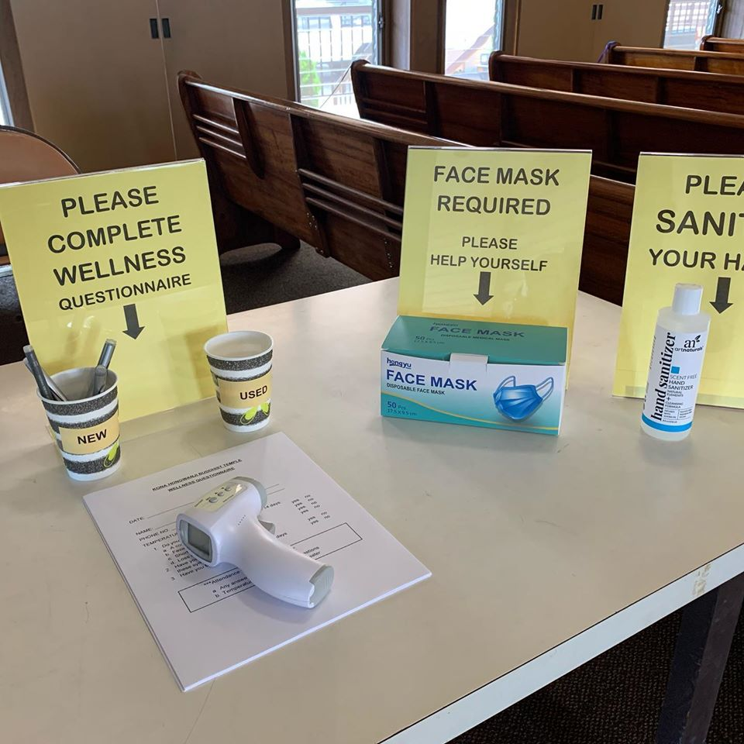
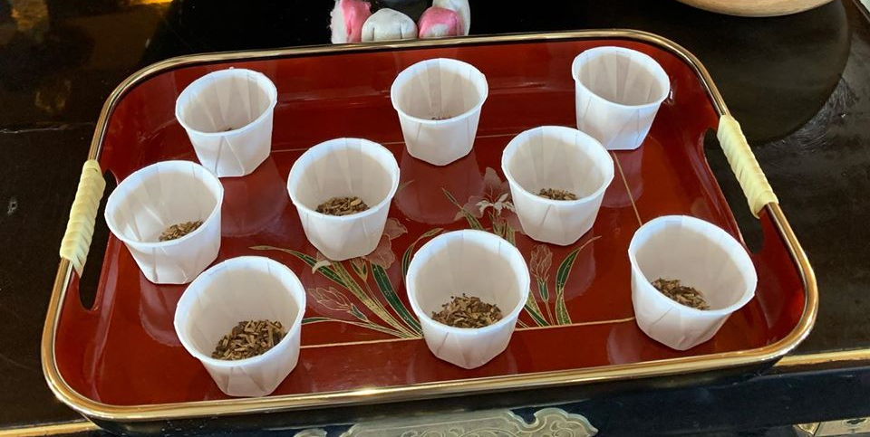
Check-in stations, signage everywhere, and individual portions of offertory incense (Makawao Hongwanji Facebook)

Slide 10
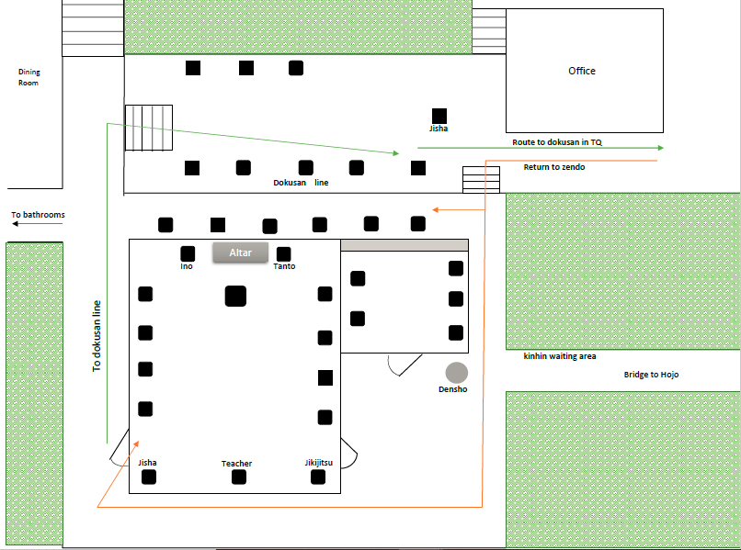
Honolulu Diamond Sangha new rules
Six-foot-spaced seated and walking meditation
Specific routes to enter and leave
Electric fan on during koan meeting with Zen master
Reduced sutra chanting
No tea service
No petting the cat

Slide 11
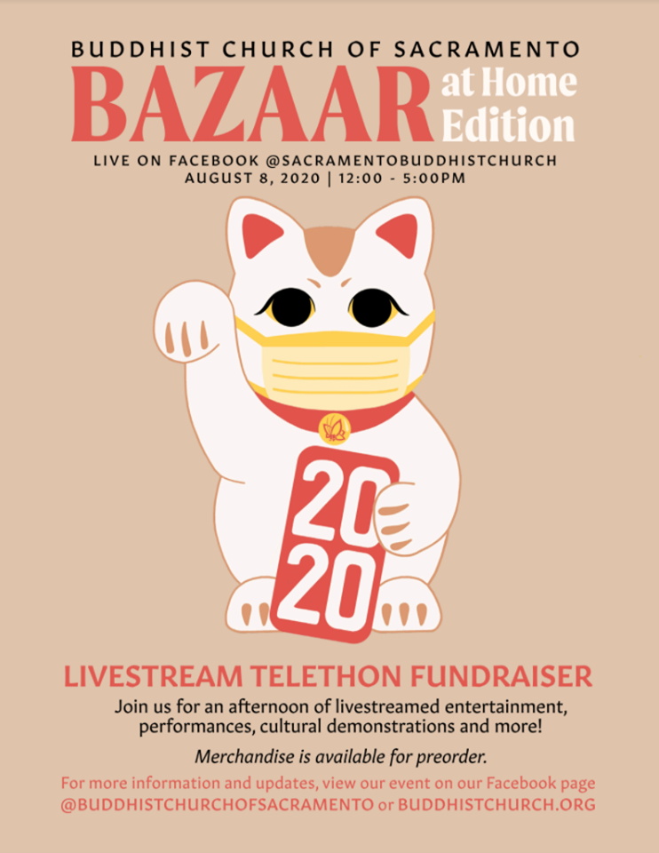
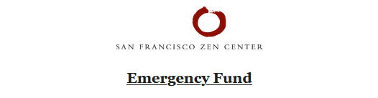
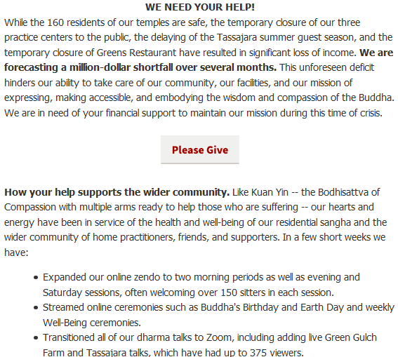

Slide 12
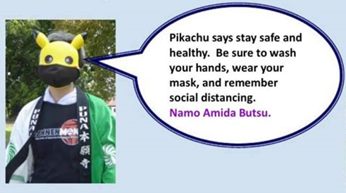
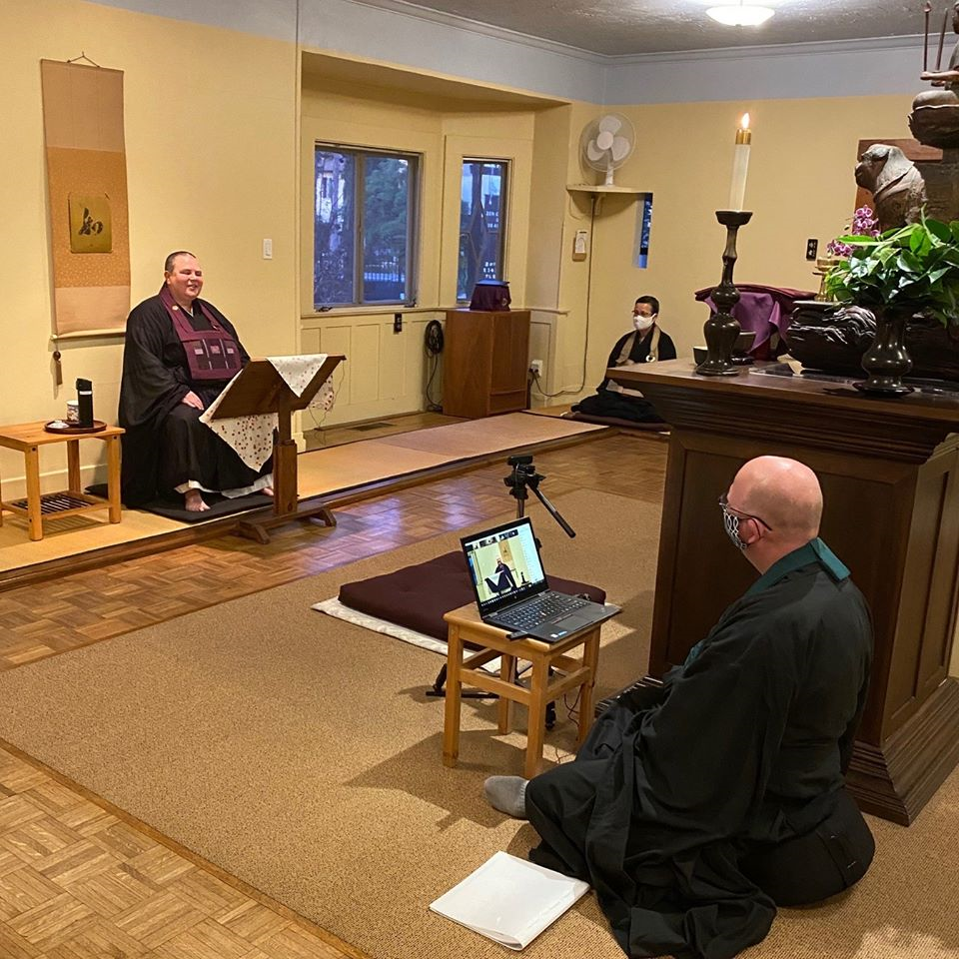
Phenomena examined
Disruption of normal services
Shift to virtual programming
Using Buddhism to teach good hygiene
Using pandemic to teach Buddhism
Reopening: ritual changes
Economic impacts and responses
Power shifts related to skillsets
Survival, adaptation, rebuilding as Buddhist practices
Distanced and livestreamed Dharma investiture at Zen Center of Los Angeles (zcla.org)

